Slide 1
Introduction
July 2019
Guy Harrison
CTO ProvenDB

Slide 2
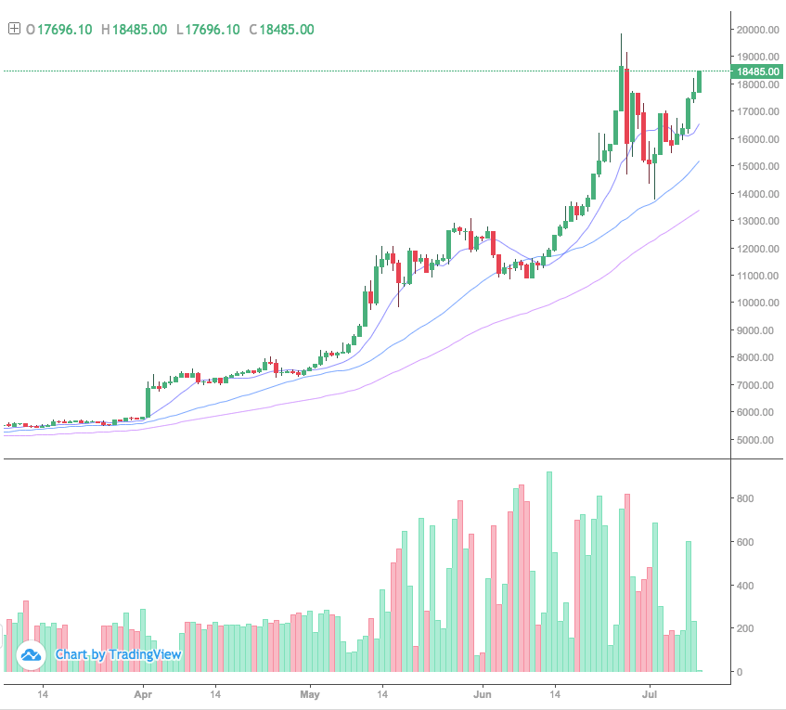
Why Blockchain?
Blockchain is well known as the technology behind Bitcoin. The Bitcoin Blockchain is a distributed transactional database that supports $200B of bitcoin today

Slide 3
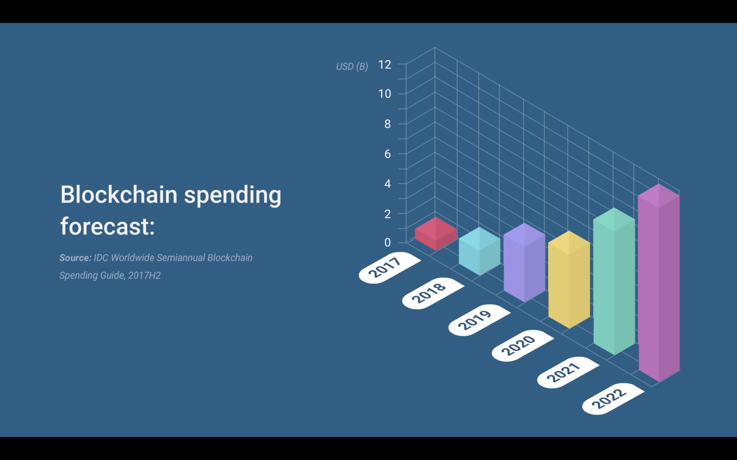
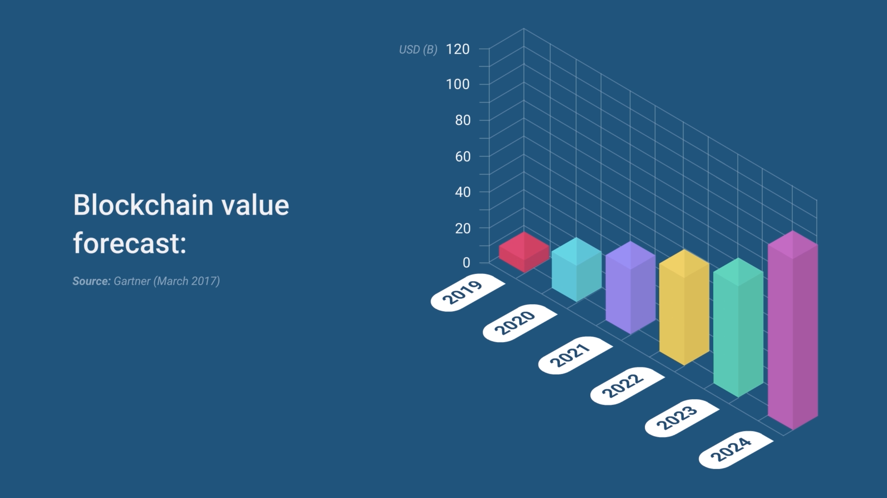

Slide 4
We’ve all heard about the blockchain
Blockchain has the potential to change the way we buy and sell, interact with government and verify the authenticity of everything from property titles to organic vegetables.
– Goldman Sachs (https://bit.ly/2Lpctck)
The blockchain is an incorruptible digital ledger of economic transactions that can be programmed to record not just financial transactions but virtually everything of value.
Hailed as a one of the biggest paradigm shifts since the internet itself
An economic/transactional layer integrated directly into the internet without the need for centralized control
Blockchain market estimated to add $176 billion business value over next 7 years.
Potentially disruptive to multiple industries and technology segments.
Including the database market….
– Don & Alex Tapscott, authors Blockchain Revolution (2016)
The business value-add of blockchain will grow to slightly more than $176 billion by 2025, and then it will exceed $3.1 trillion by 2030.
– Gartner (G00325744)
[blockchain] is revolutionary and has the potential to revolutionize nearly every industry.
– Forbes (https://bit.ly/2Oc23C5)
The overall market for database management solutions, [is] valued by IDC to be over $50 billion by 2018.
– Forbes (https://bit.ly/2Q5OJMY)

Slide 5
Blockchain vs DBMS
The Blockchain represents a new type of database:
Tamper Proof
Immutable History
Distributed
Public
Transactions on the Blockchain cannot be altered and are cryptographically proven.
The full history of all Blockchain transactions is preserved.
The Blockchain has no central administrator or centralized data storage
Transactions on the Blockchain are public (though they may be anonymous).

Slide 6
Immutability is Revolutionary
Trust is a foundational feature of the blockchain as the data written into it is immutable, and can never be changed, modified or removed.
They say history is written by the winners.
In databases, history is written by the developer or the DBA.
There’s no practical way to detect back-dating or tampering with historical data.
But there’s no arguing with blockchain data.
Once sealed on the blockchain, historical data is immune from modification.
– Wall Street Journal (https://on.wsj.com/2PJ1Wem)

Slide 7

Legal recognition is emerging…
Arizona Bill HB2603
2016 Vermont StatutesTitle 12
Hangzhou Internet Court (China)
National Conference of State Legislatures
A signature that is secured through Blockchain technology is considered to be in an electronic form and to be an electronic signature.
A digital record electronically registered in a Blockchain shall be self-authenticating pursuant to Vermont Rule of Evidence 902.
The usage of a third-party Blockchain platform that is reliable without conflict of interests provides the legal ground for proving the intellectual infringement.
Blockchain legislation pending or passed in at least 18 US states.
https://www.azleg.gov/ars/44/07061.htm
https://bit.ly/20FHNtS
https://bit.ly/2R8dw3H
https://bit.ly/2L40ksc

Slide 8
Blockchain vs DBMS
Compared to a traditional DBMS, the blockchain has many drawbacks:
Performance
Capacity
Structure
High Latency, low throughput
Minimal data storage capacity
No Schema or data model
Privacy
Productivity
Cost
APIs are complex and unfamiliar
Transactions are publicly visible
Each transaction has a significant cryptocurrency cost

Slide 9
The economics are ruinous

Slide 10
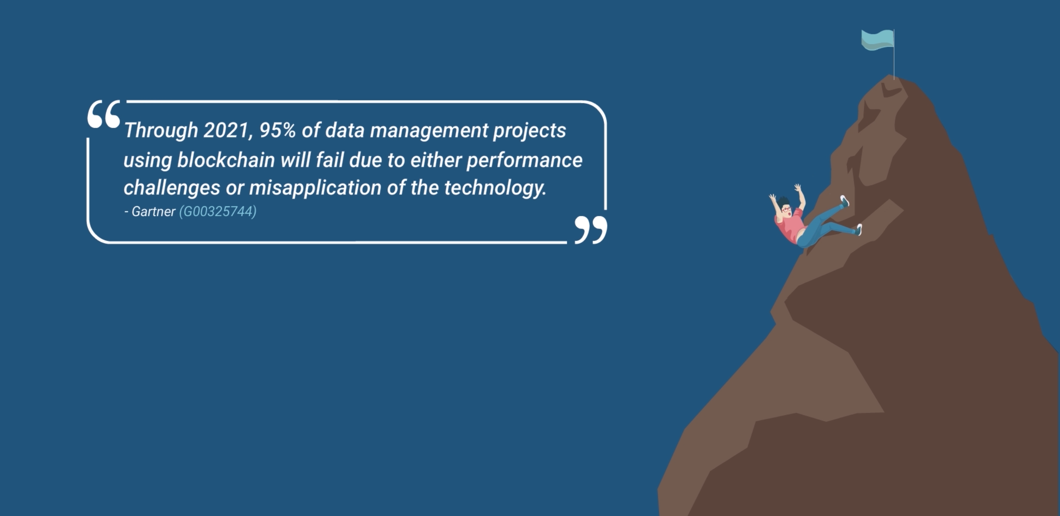
Blockchain projects are very risky

Slide 11

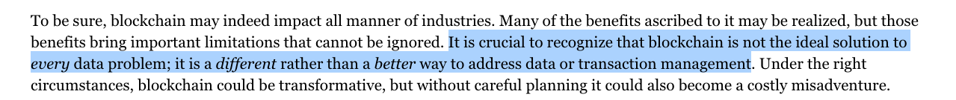
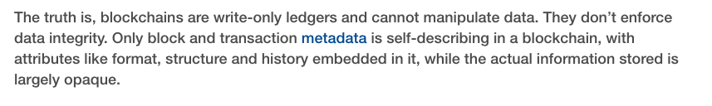
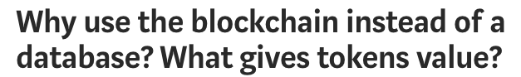
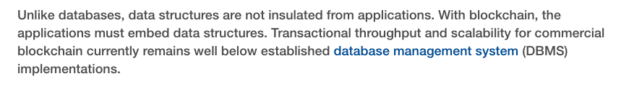
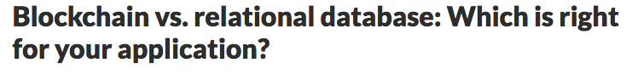
This is the dilemma:
Use a database and sacrifice immutability and tamper detection
OR
Use the blockchain at great risk and sacrifice performance and economics

Slide 12
ProvenDB

Slide 13
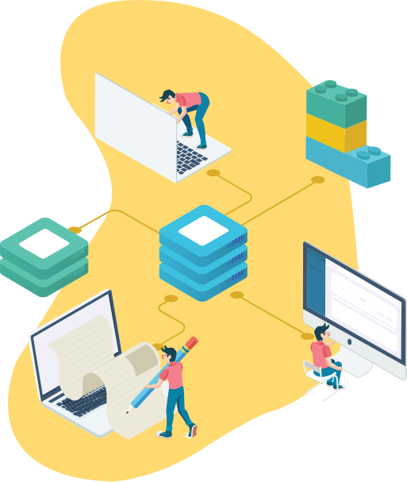
About ProvenDB
Blockchain
ProvenDB bridges the gap between Database and Blockchain technology.
ProvenDB enables the rapid development of high-performance Blockchain applications.
ProvenDB can add Blockchain capabilities to any existing MongoDB application.
MongoDB
ProvenDB

Slide 14








ProvenDB bridges the gap
A fully functional database service:
Blockchain integration:
MongoDB storage layer
Versioning of data
Point-in-time history
Normal throughput and latency
Immutabillity
Complete data provenance
Rich query and database operations
Tamper detection
Strong privacy

Slide 15





How is ProvenDB different?
Versioning of Data
Tamper Detection
Complete Data Provenance
New data doesn't over write old data – instead a new version of the data is created.
Any attempt to tamper with database records can be detected by Blockchain technology.
View the complete history of changes to any data item.
Immutability
Point-in-time History
Selected versions of data are “pinned” to the Blockchain and cannot be altered.
The state of the database at previous points in time is always available.

Slide 16




Why use ProvenDB?
To prove you created some content – intellectual property for instance.
To prove that a document or data has not been tampered with or altered.
To prove the date of a legal or official document.
To prove the exact history (provenance) of some data.

Slide 17






Applications that would benefit from ProvenDB
Document management systems
Legal record keeping
Intellectual Property and Media Management Solutions
Audit and Access Control Systems
Accounting Systems
Government and Regulatory Applications

Slide 18
How does ProvenDB work?

Slide 19
How ProvenDB Works
ProvenDB
1.
Transactions to ProvenDB are stored (append-only) in the MongoDB database and hashes of the transactions posted to the Blockchain.
MongoDB
Database User
2.
Each transaction creates a new version within the database. The database user or application can explore older versions and their proofs at any time.
Blockchain
3.
The database user requests a proof be placed on the Blockchain for a specific version. This version can be used to prove the timestamp of the entire version or any document in that version.

Slide 20

Hash Signatures
A hash is a mathematical "signature” of a document – a digital finger print
The chances of two documents having the same hash are infinitesimally small –
Even if every computer in the world today generated hashes as fast as it could, it would still take many times longer than the lifetime of the universe to find a duplicate
In practice, hashes are far more precise proofs of identity than DNA or fingerprints.
Document
Hash

Slide 21
Blockchain Basics
2.
Calculating the block hash is computationally expensive. First node on the Blockchain network to correctly calculate the hash is rewarded with bitcoins.
Blockchain
Block
Block
Block
Block
1,048,576
1,048,577
1,048,578
1,048,579
3.
Proof of Work
Proof of Work
Proof of Work
Proof of Work
Changing a transaction on the Blockchain requires rebuilding the block and all subsequent blocks faster than the all of the current nodes on the Blockchain network.
This becomes effectively impossible the deeper the block is on the chain. Once data is embedded in the Blockchain, it requires an impossibly large amount of computing power to change it.
000000rejf67
000000ueri32
0000007uy654
00000078ujma
Previous Block
Previous Block
Previous Block
Previous Block
000000erw562
000000rejf67
000000ueri32
0000007uy654
Transaction IDs
Transaction IDs
Transaction IDs
Transaction IDs
743ojd 8932ue iuy76
Io8548 9765mp twej45
mj721t ijdy73 mp06gv
jiu6ub 2xc432 09okju
1.
Each block on the Blockchain contains a hash of all transactions and a hash of the previous block's hash.

Slide 22
Blockchain Proofs
Hash
Document
X
1.
The simplest way to perform proof of existence is to hash the document and push that hash to the Blockchain.
Once the hash is embedded in the Blockchain, it can be used to prove that the document:
Existed on that date
Has not been tampered with
Was created by a specific individual
Block
Block
Block
1,048,577
1,048,578
1,048,579
Proof of Work
Proof of Work
Proof of Work
000000rejf67
000000ueri32
0000007uy654
2.
There are two problems with this approach:
Each document requires it’s own Blockchain transaction - expensive and environmentally irresponsible.
The document can be lost or altered in which case the proof is useless.
Previous Block
Previous Block
Previous Block
000000erw562
000000rejf67
000000ueri32
Transaction IDs
Transaction IDs
Transaction IDs
743ojd 8932ue iuy76
Io8548 9765mp twej45
mj721t ijdy73 mp06gv
Blockchain

Slide 23
Aggregating hashes using Merkle trees
Hash all documents
2.
We don’t need the whole tree to prove an individual document is included in the final hash - we just need the “merkle path”.
Build binary tree of hashed hashes
1.
We can prove multiple documents with a single hash using a “merkle tree”.
Place final “root” hash on Blockchain
3.
Thousands of documents can be included in a single merkle tree - all anchored to a single Blockchain transaction.

Slide 24
A persistent versioned database
ProvenDB
1.
Transactions to ProvenDB are stored (append-only) in the MongoDB database and hashes of the transactions posted to the Blockchain.
MongoDB
Database User
2.
Each transaction creates a new version within the database. The database user or application can explore older versions and their proofs at any time.
Blockchain
3.
The database user requests a proof be placed on the Blockchain for a specific version. This version can be used to prove the timestamp of the entire version or any document in that version.

Slide 25
Demo

Slide 26
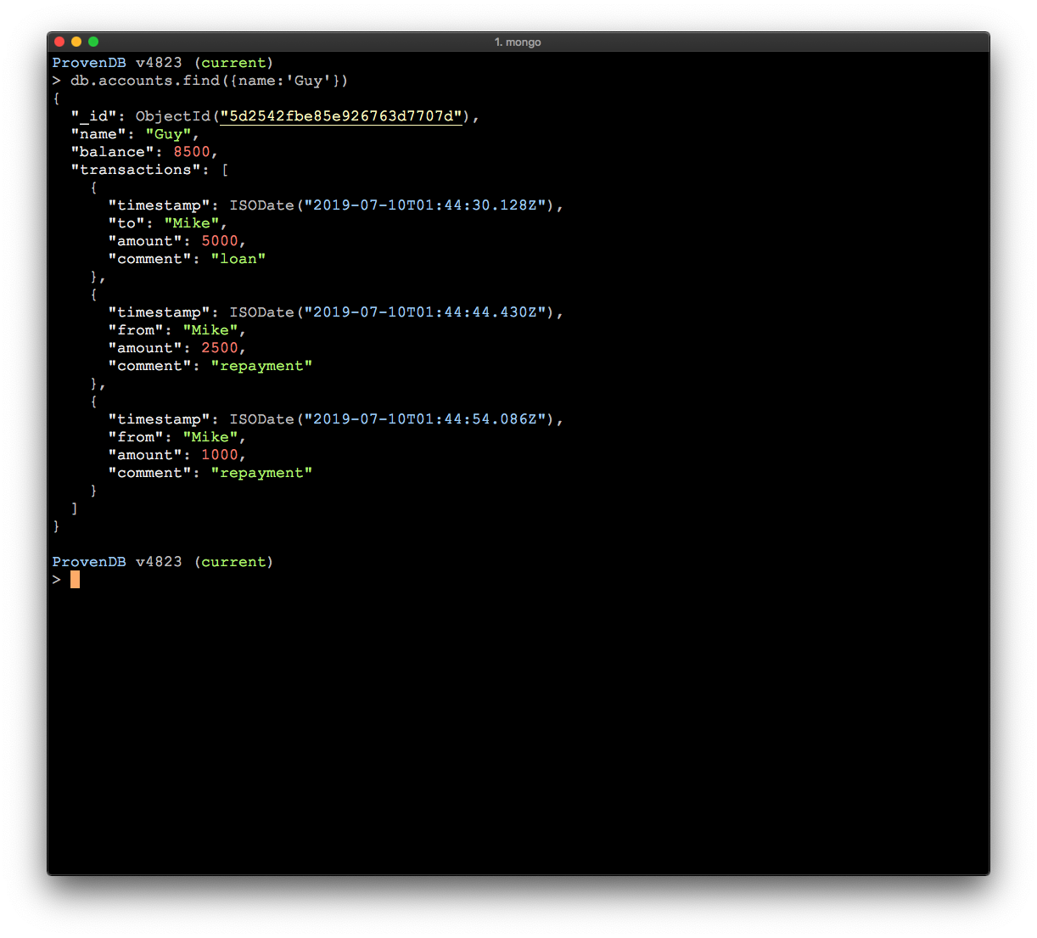
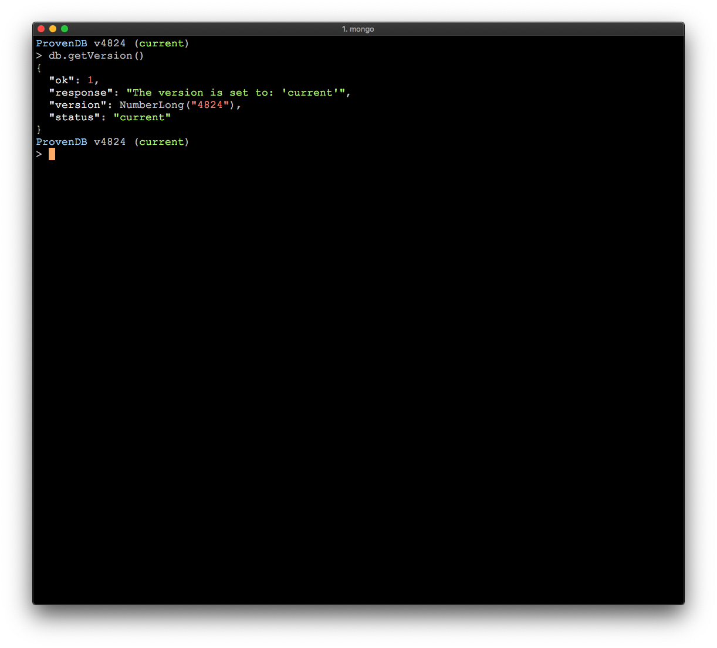
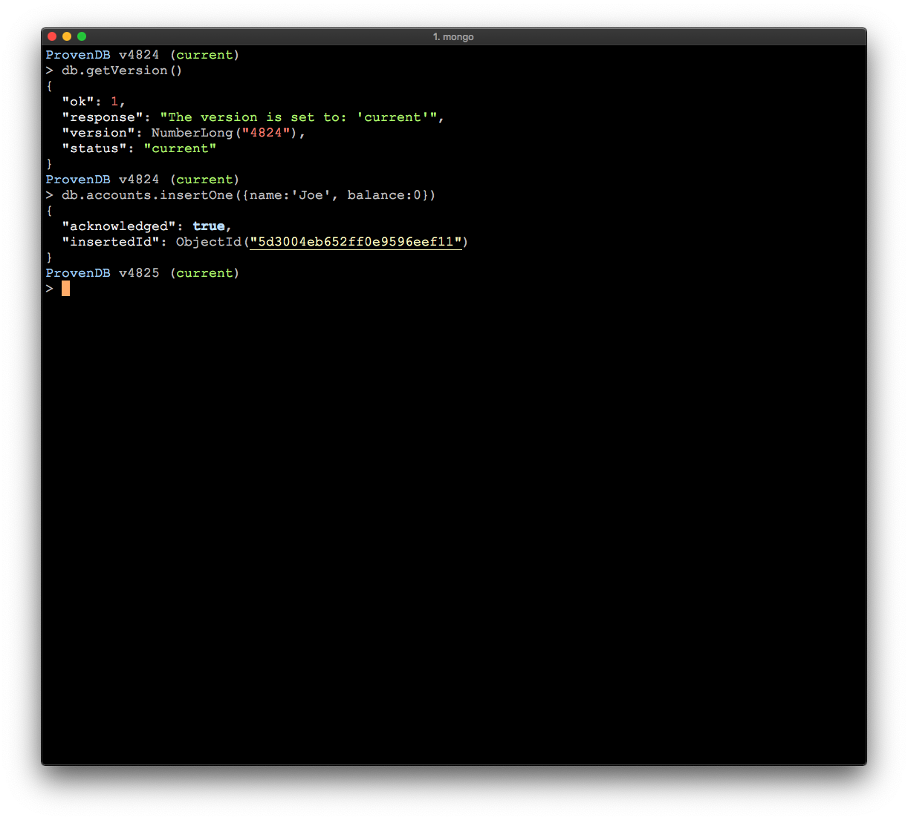
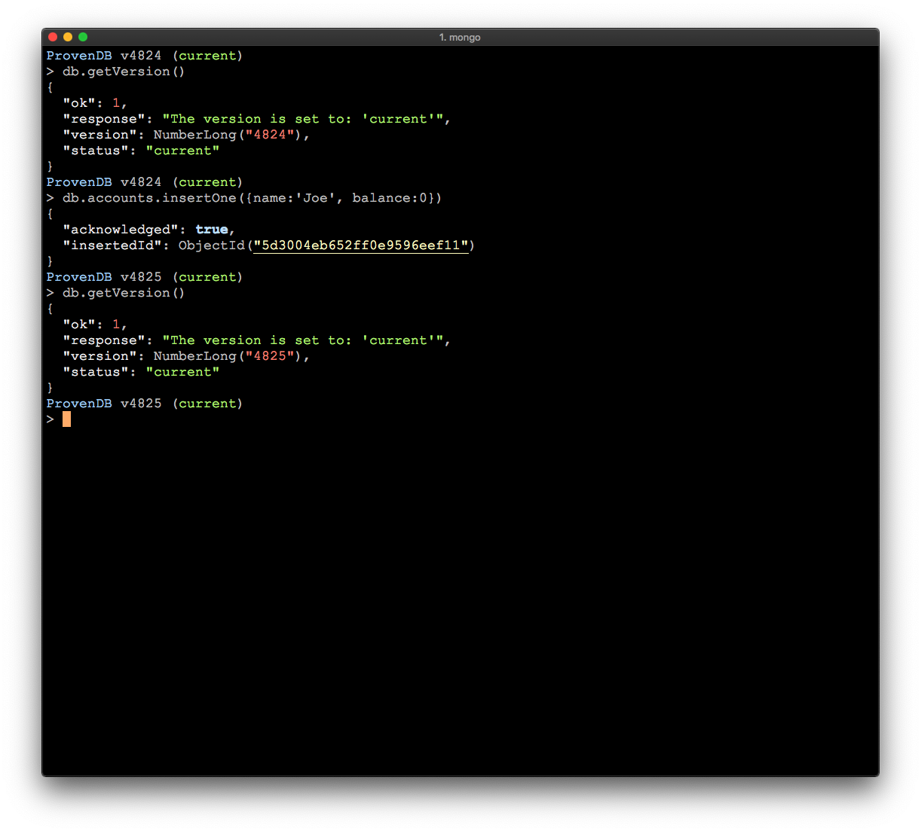
ProvenDB acts like MongoDB.
All the usual commands are supported.
ProvenDB is a versioned Database.
Every insert/ update/ delete increases the version number

Slide 27
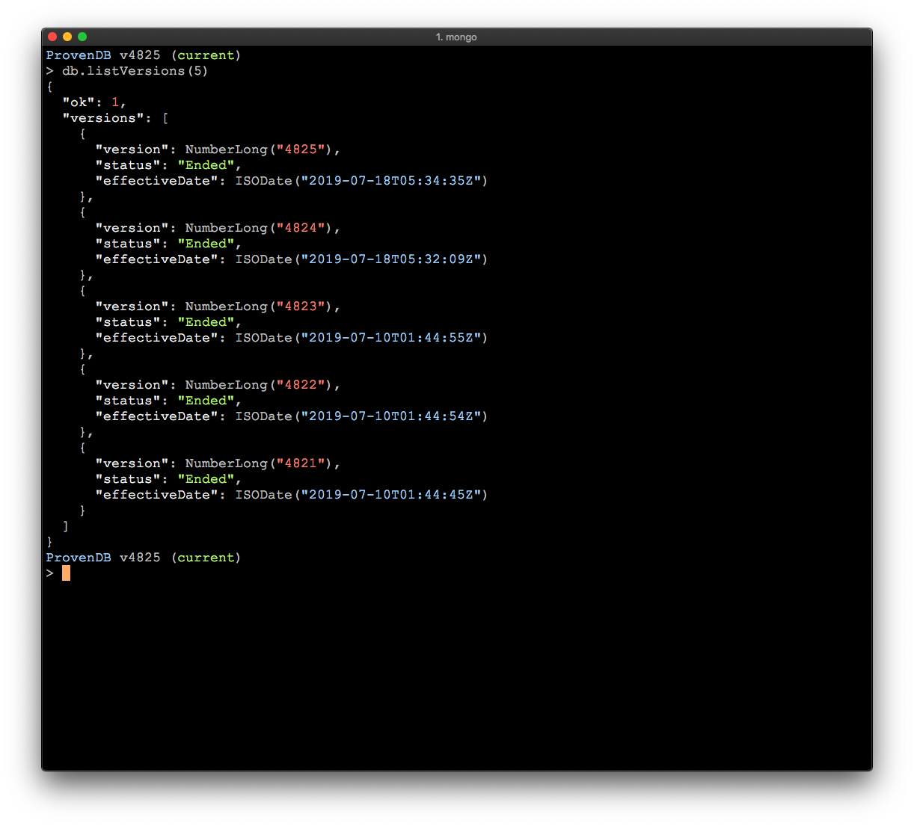

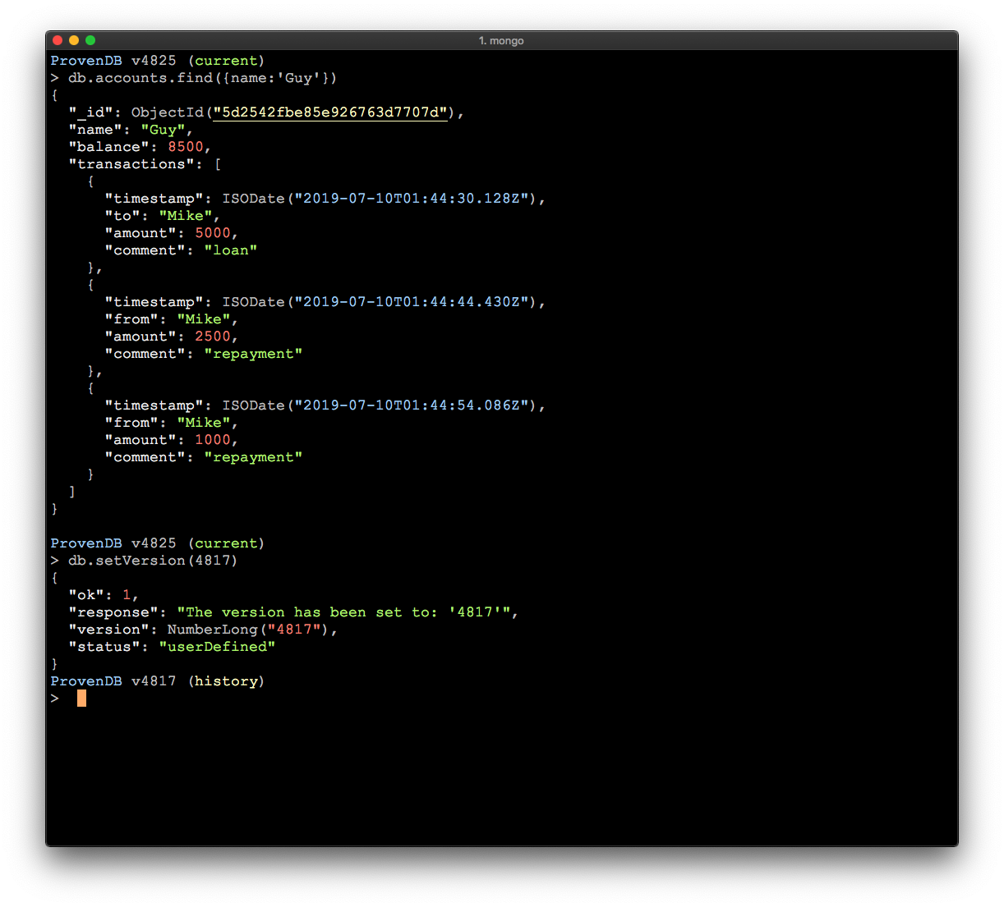
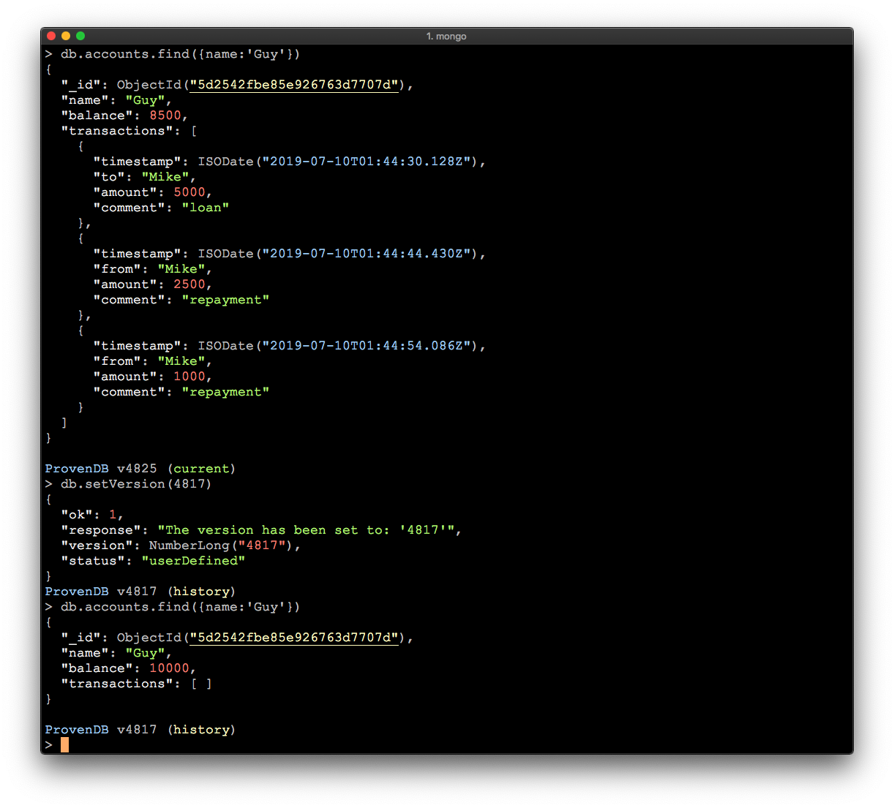
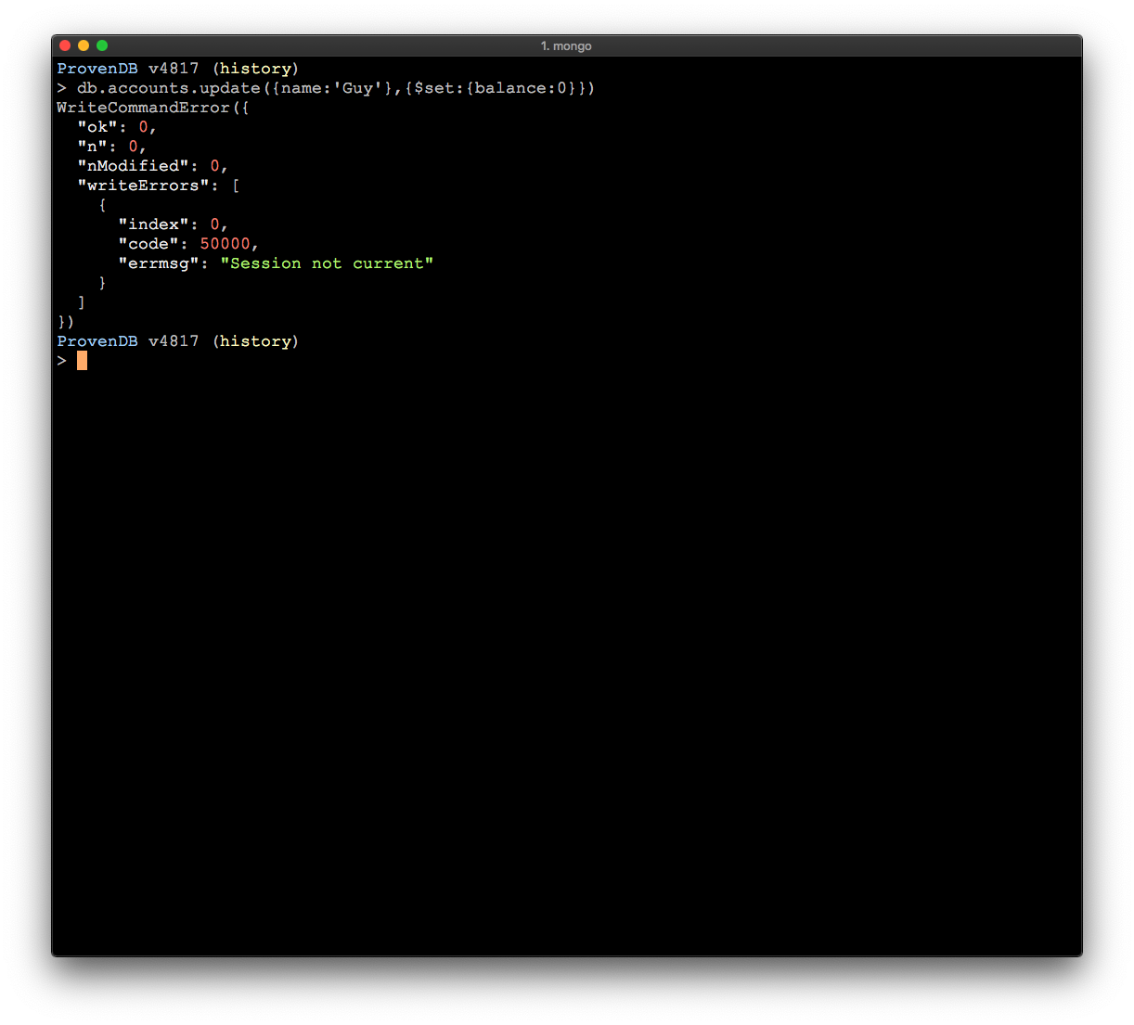
We can view and navigate to previous versions.
Previous versions are read-only

Slide 28
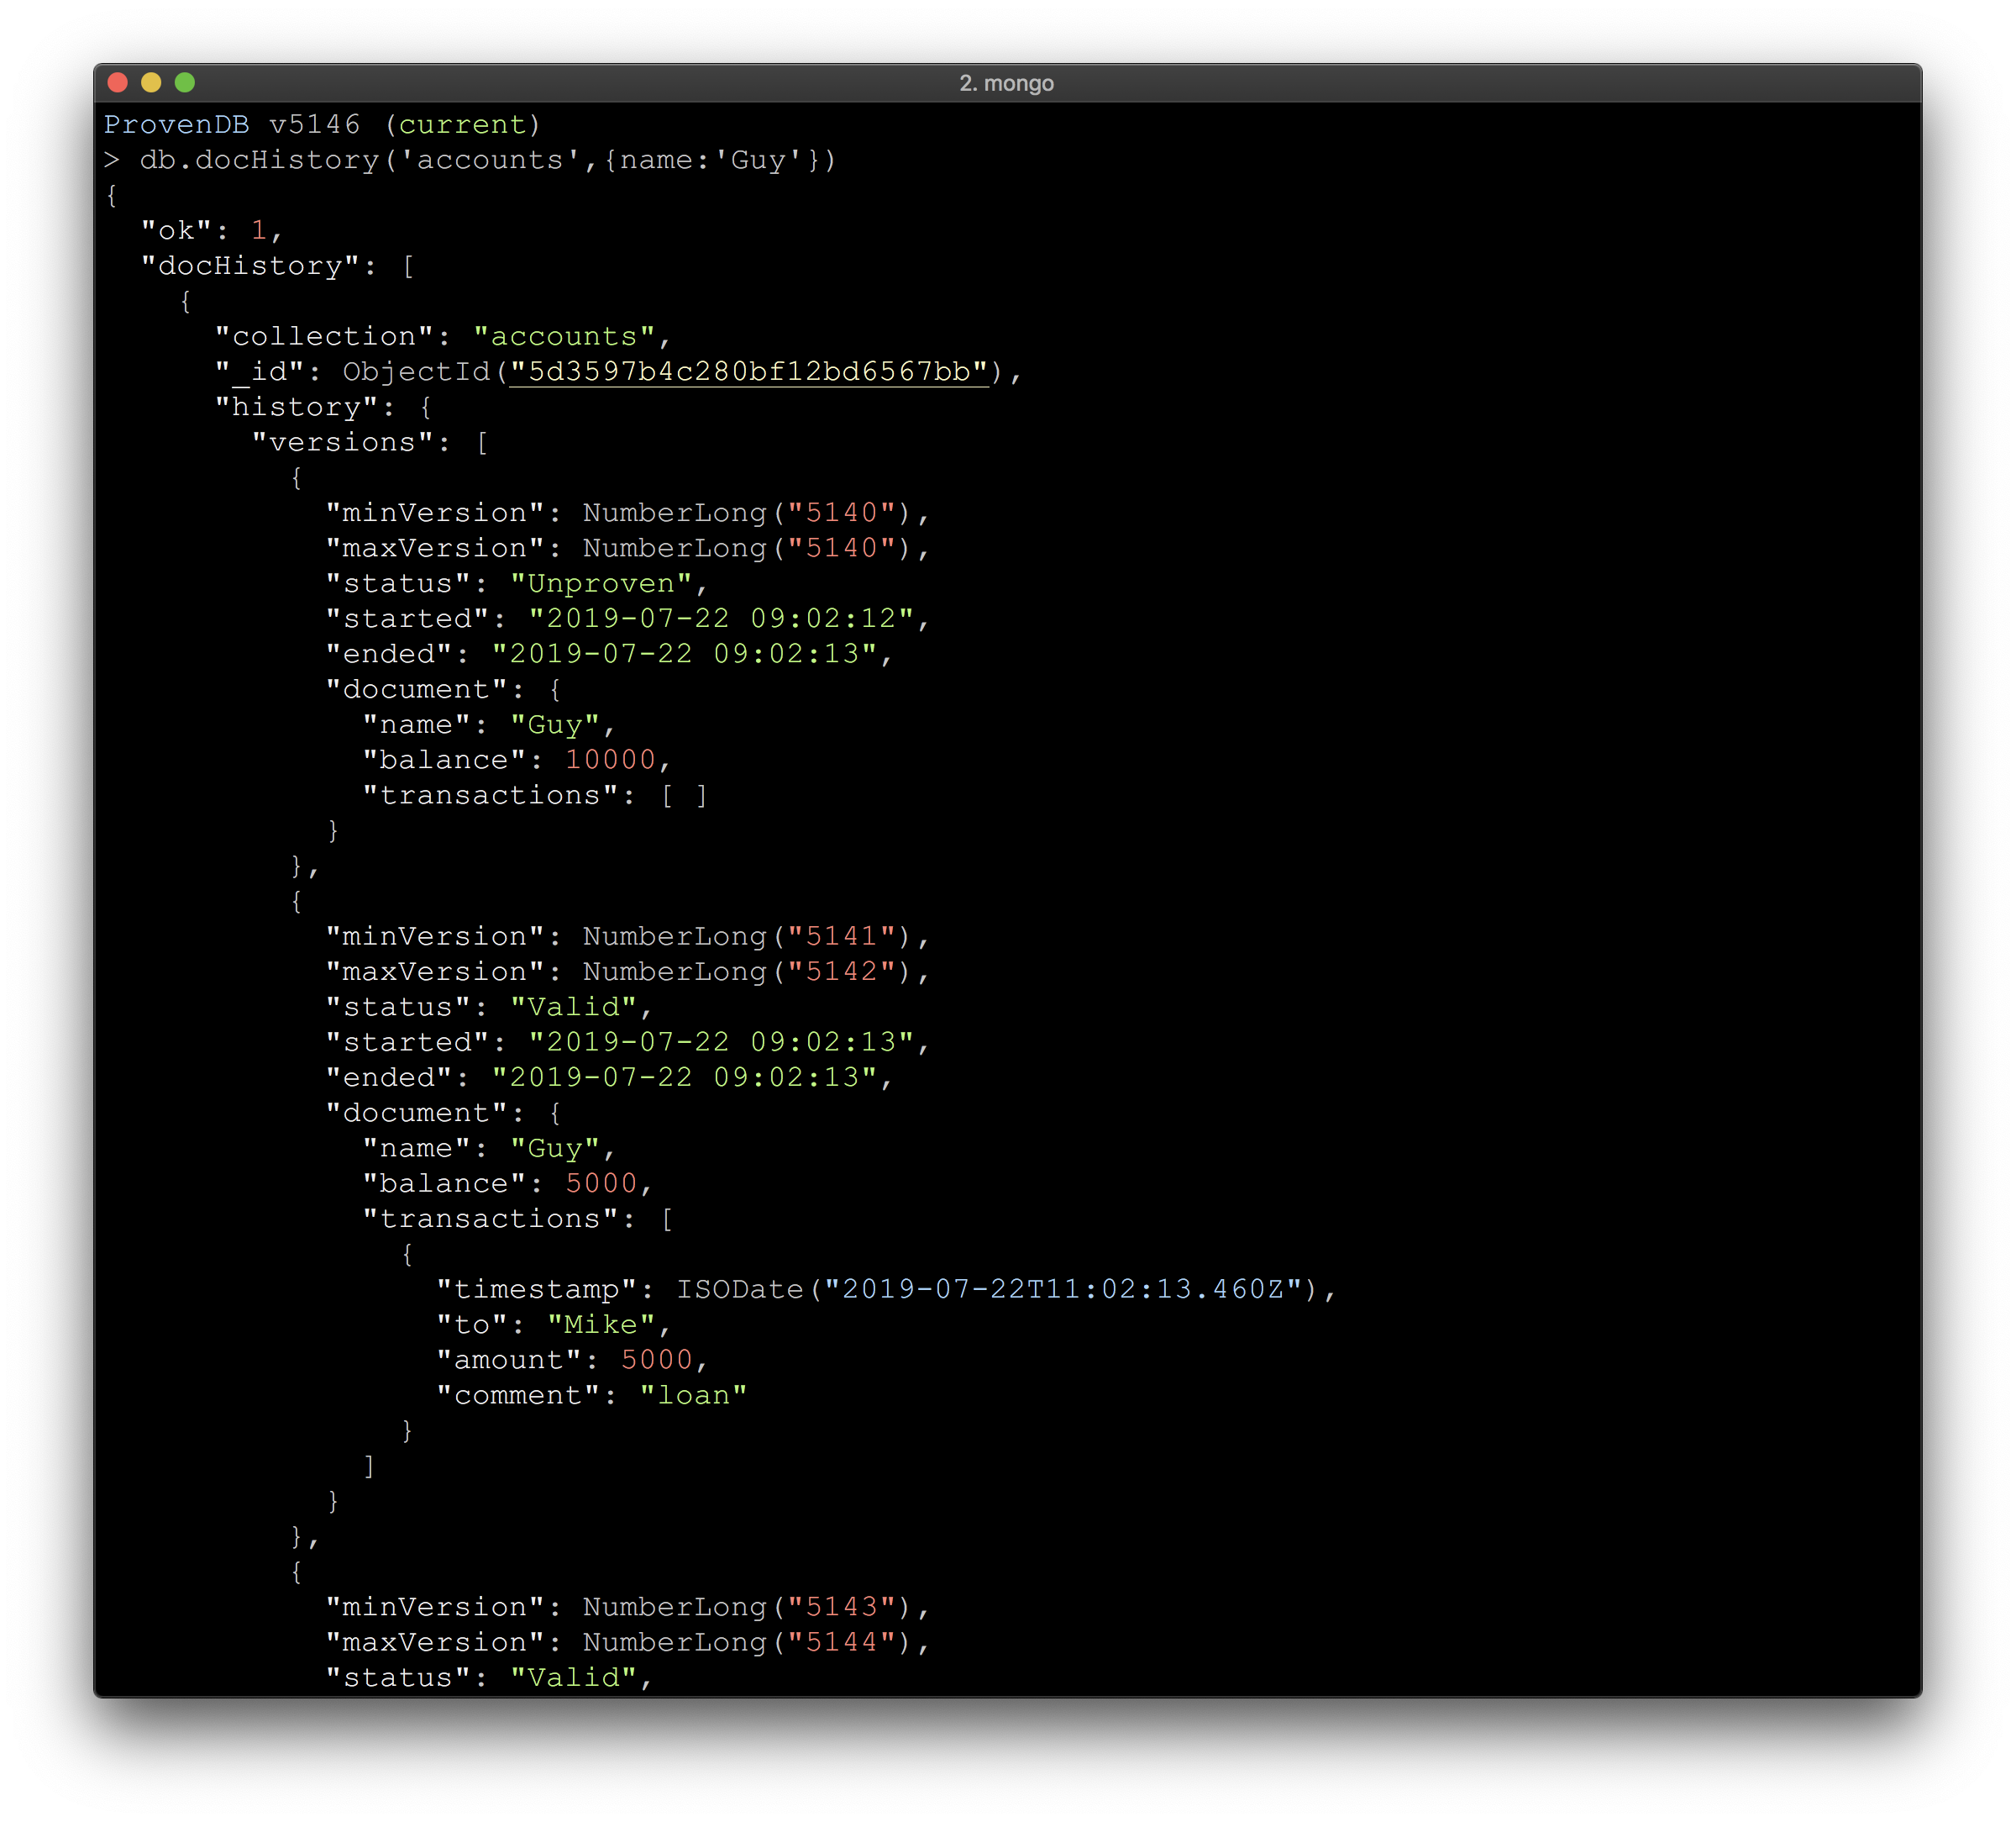
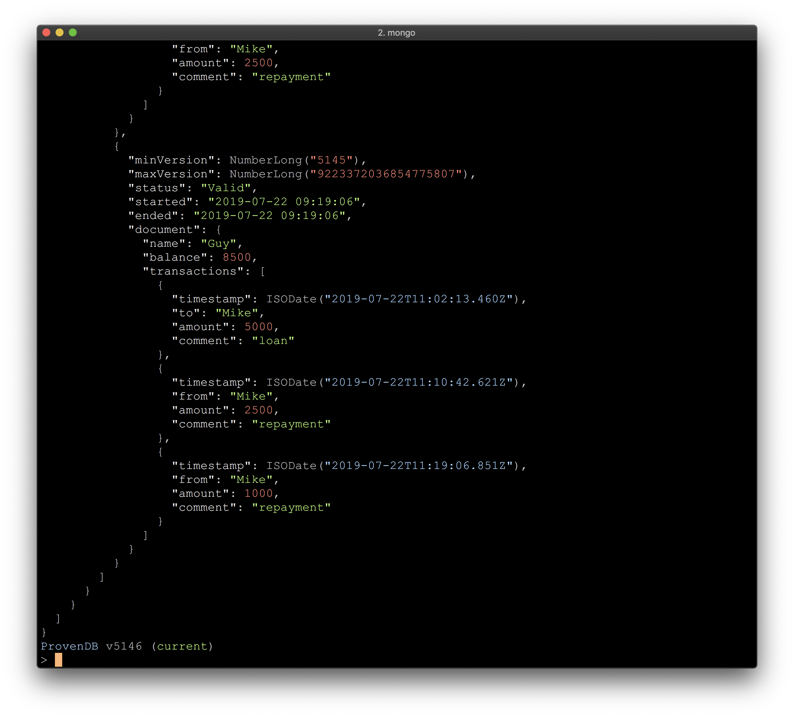
We can see the complete history of given documents

Slide 29
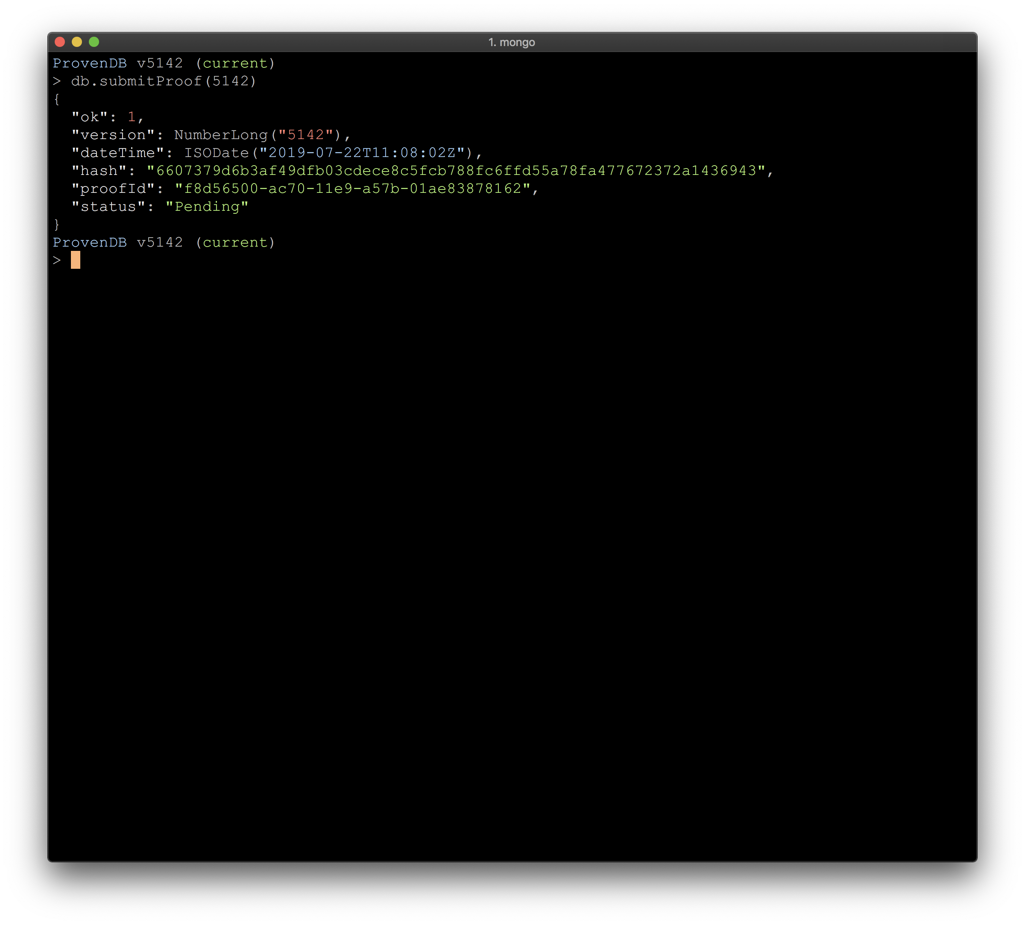
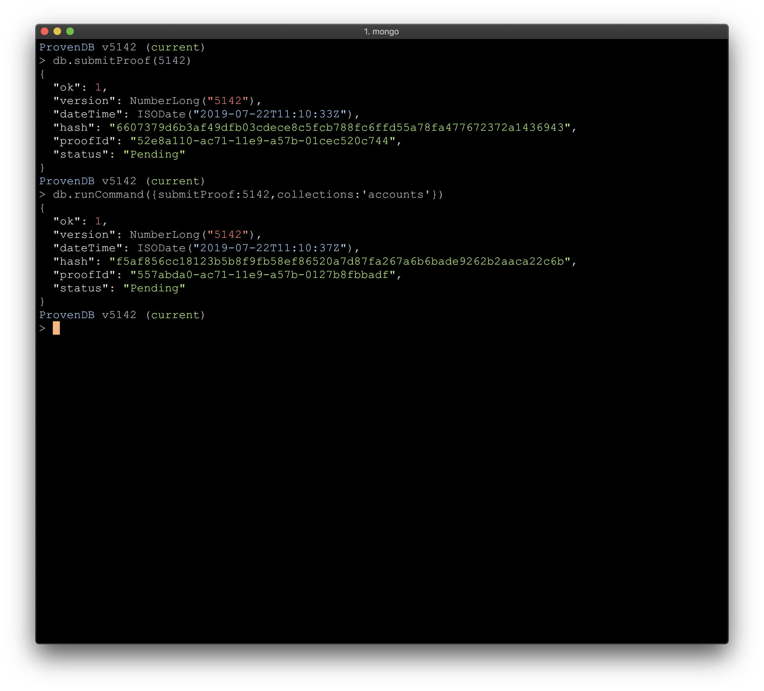
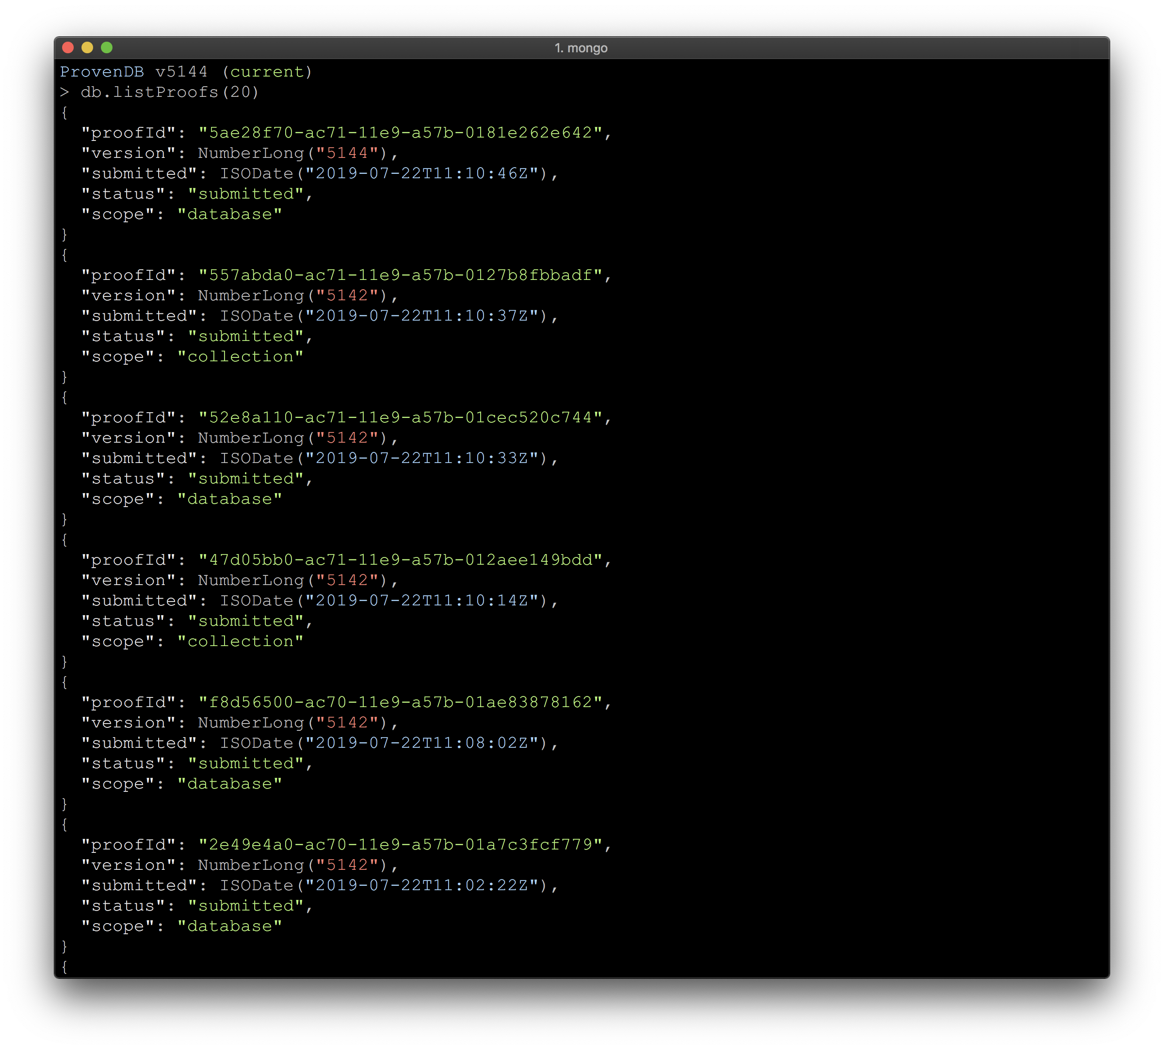
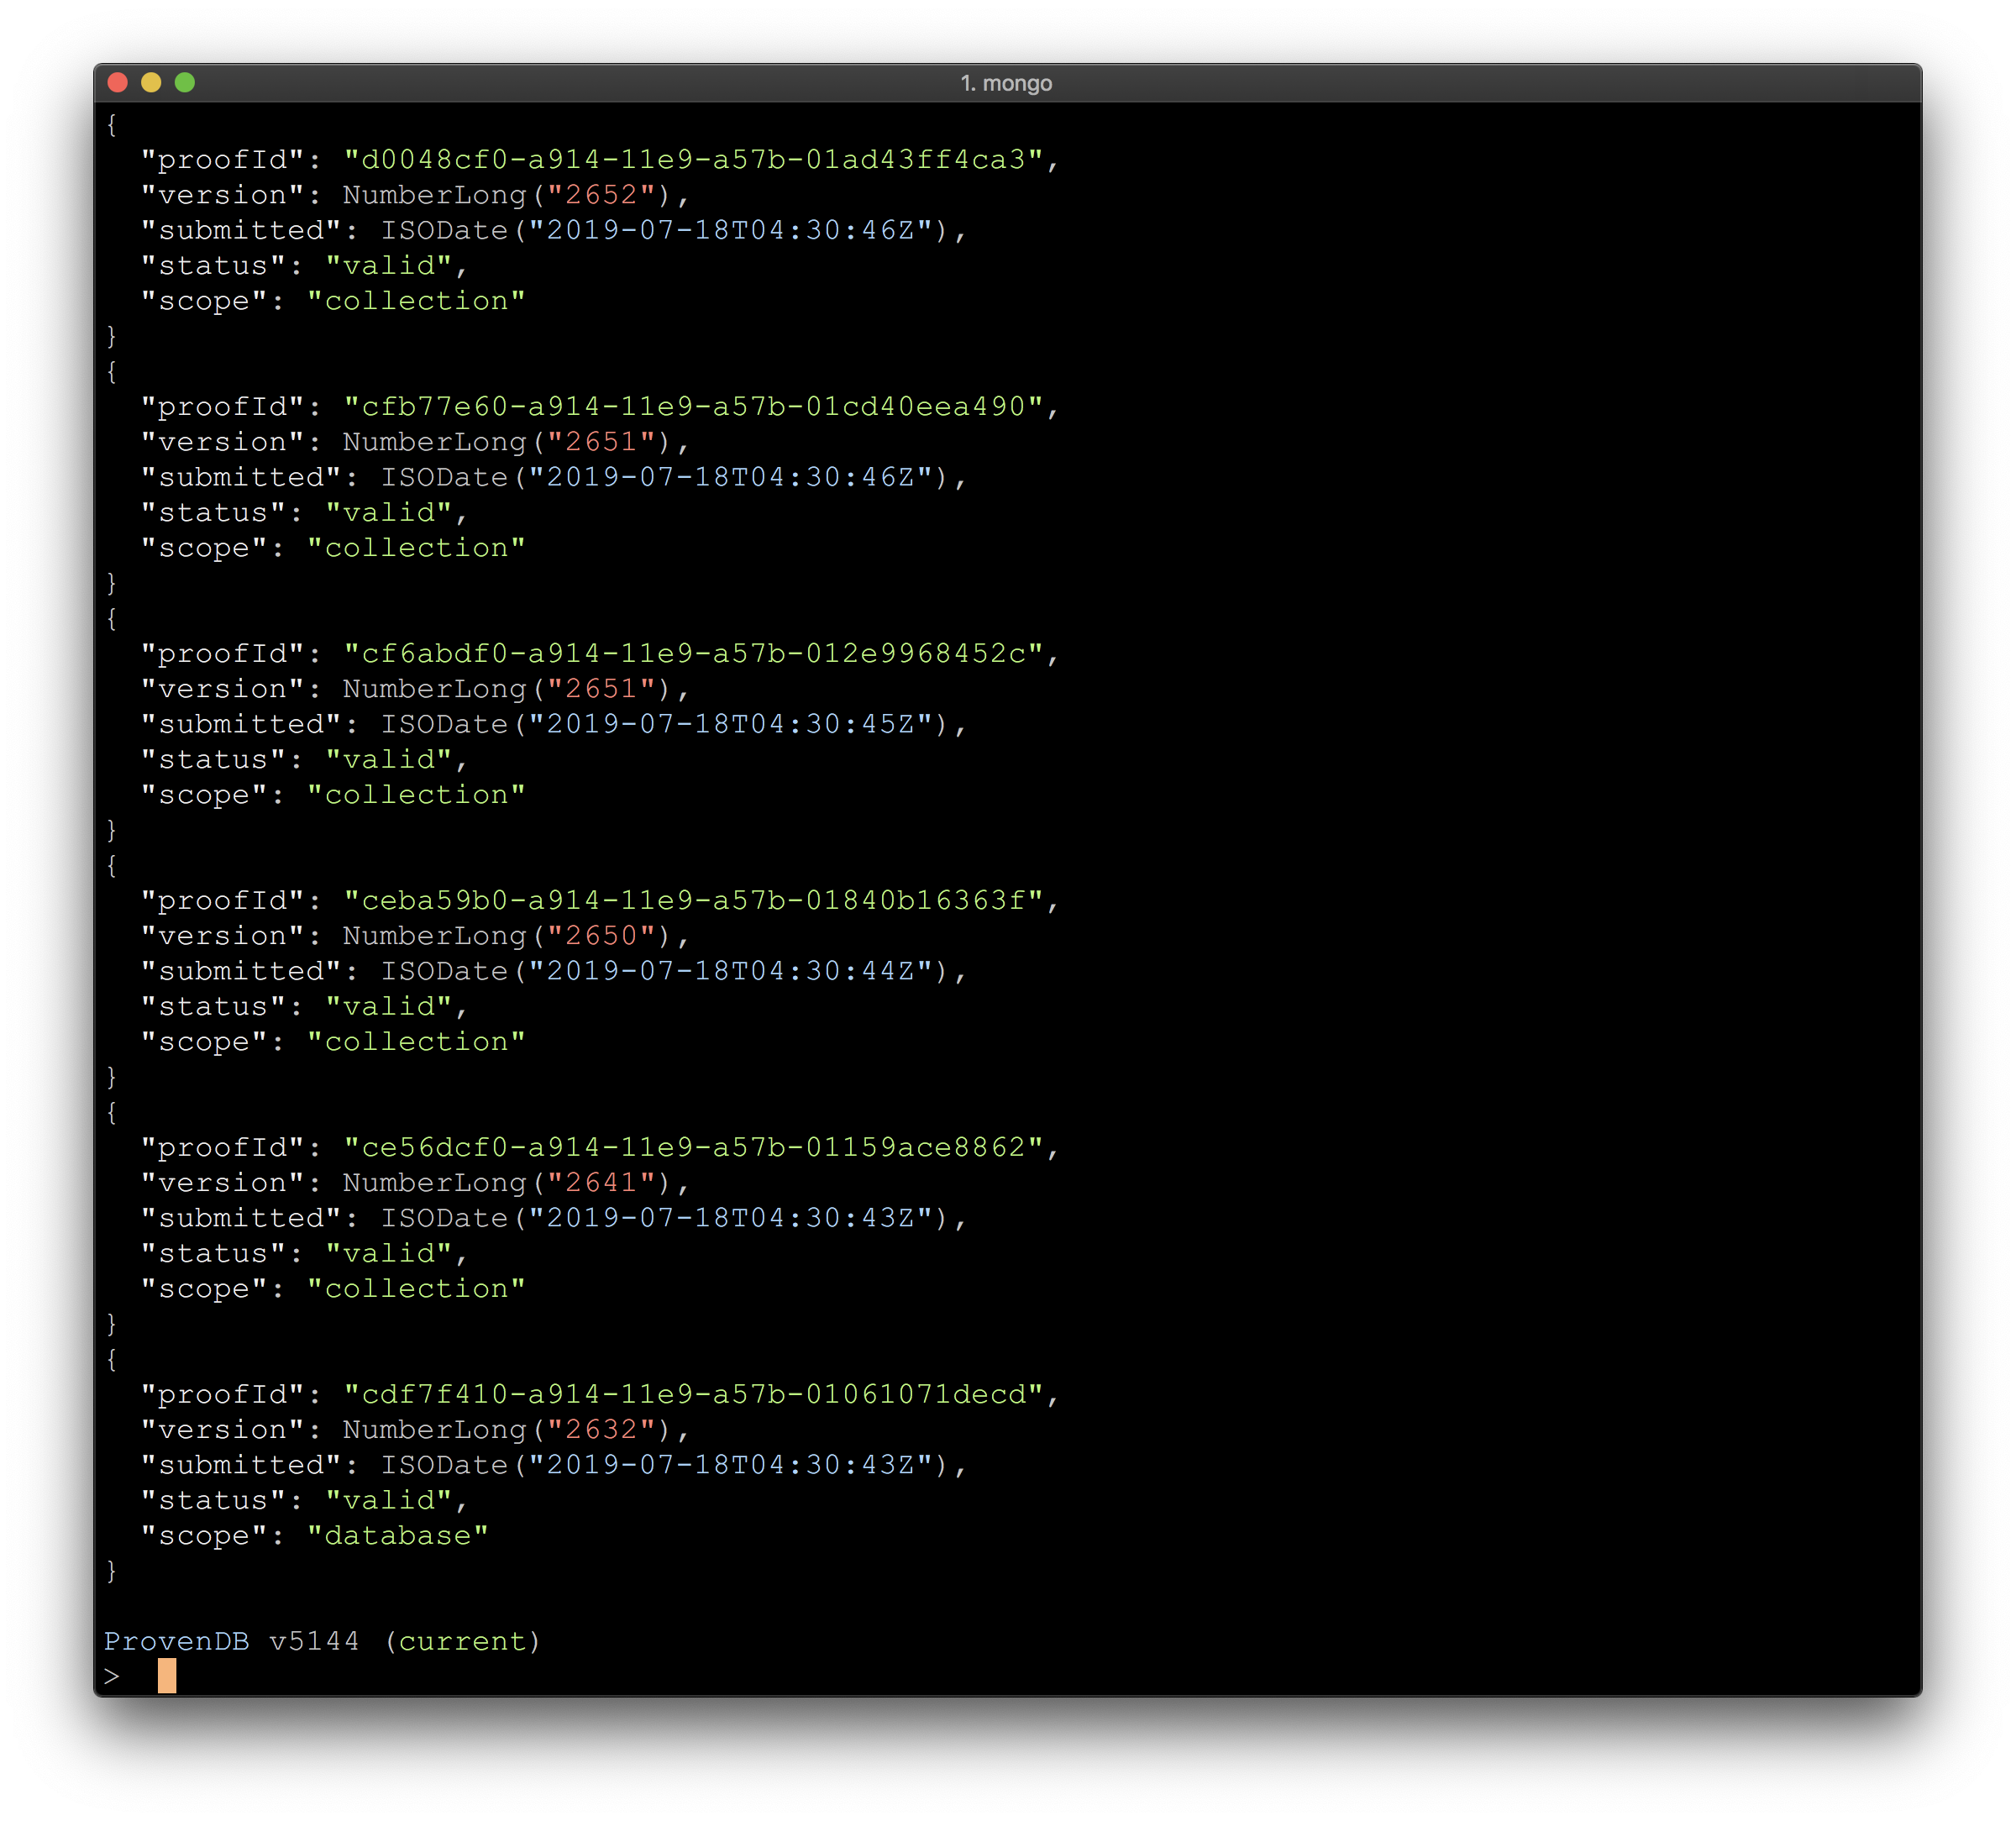
Submit Proof places a proof for an entire database version on the blockchain
We can also submit a proof for a specific collection
We can list and search for proofs and versions

Slide 30
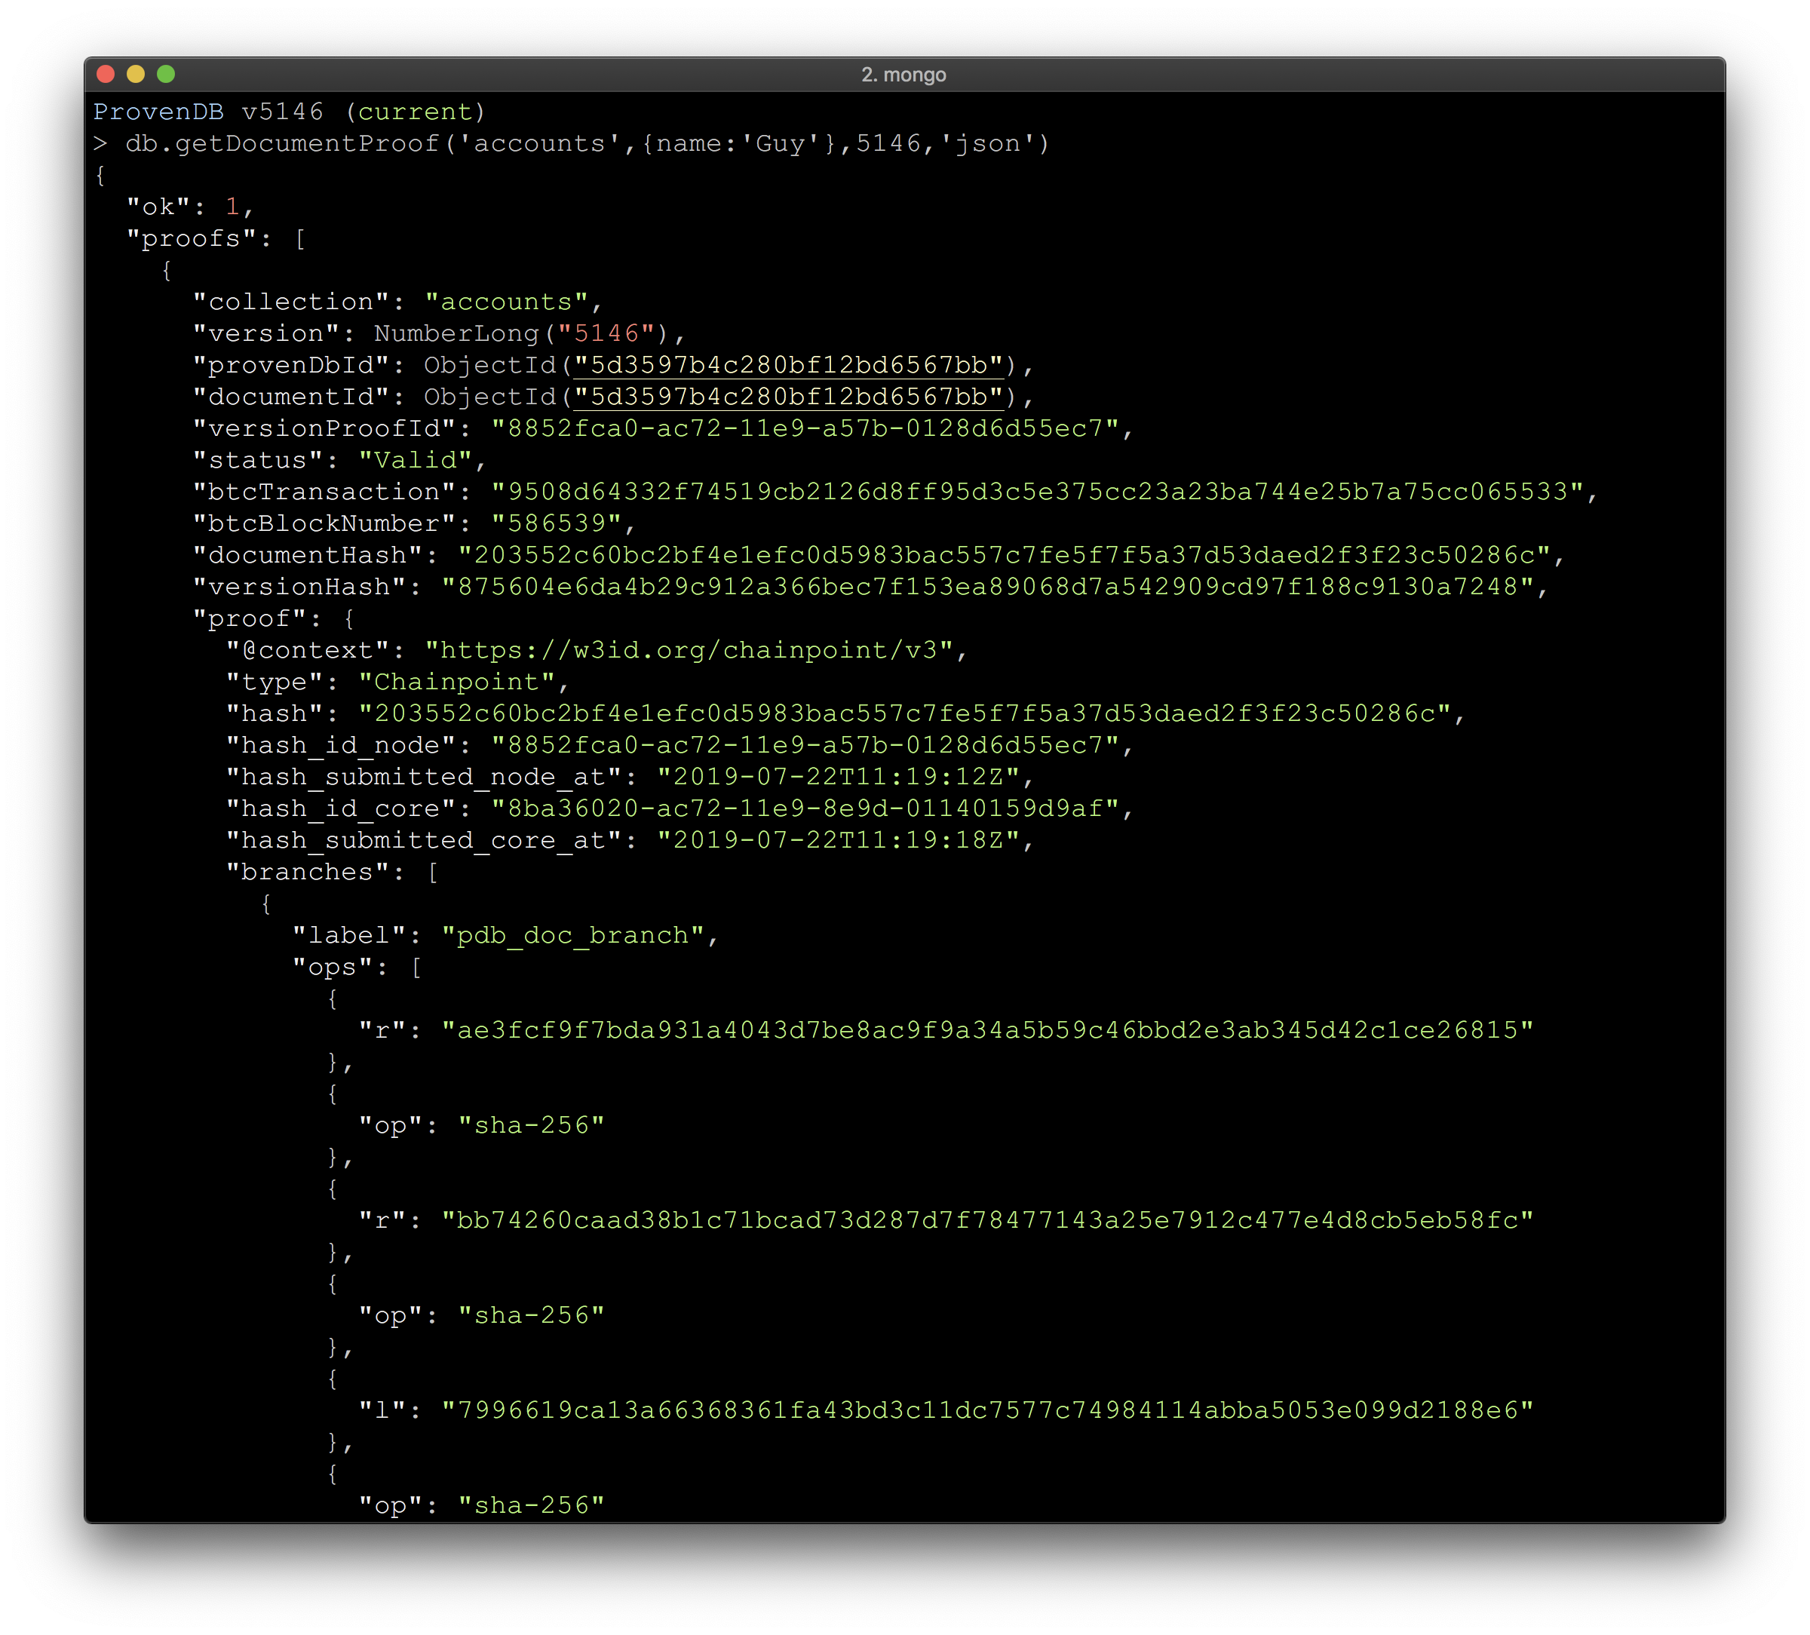
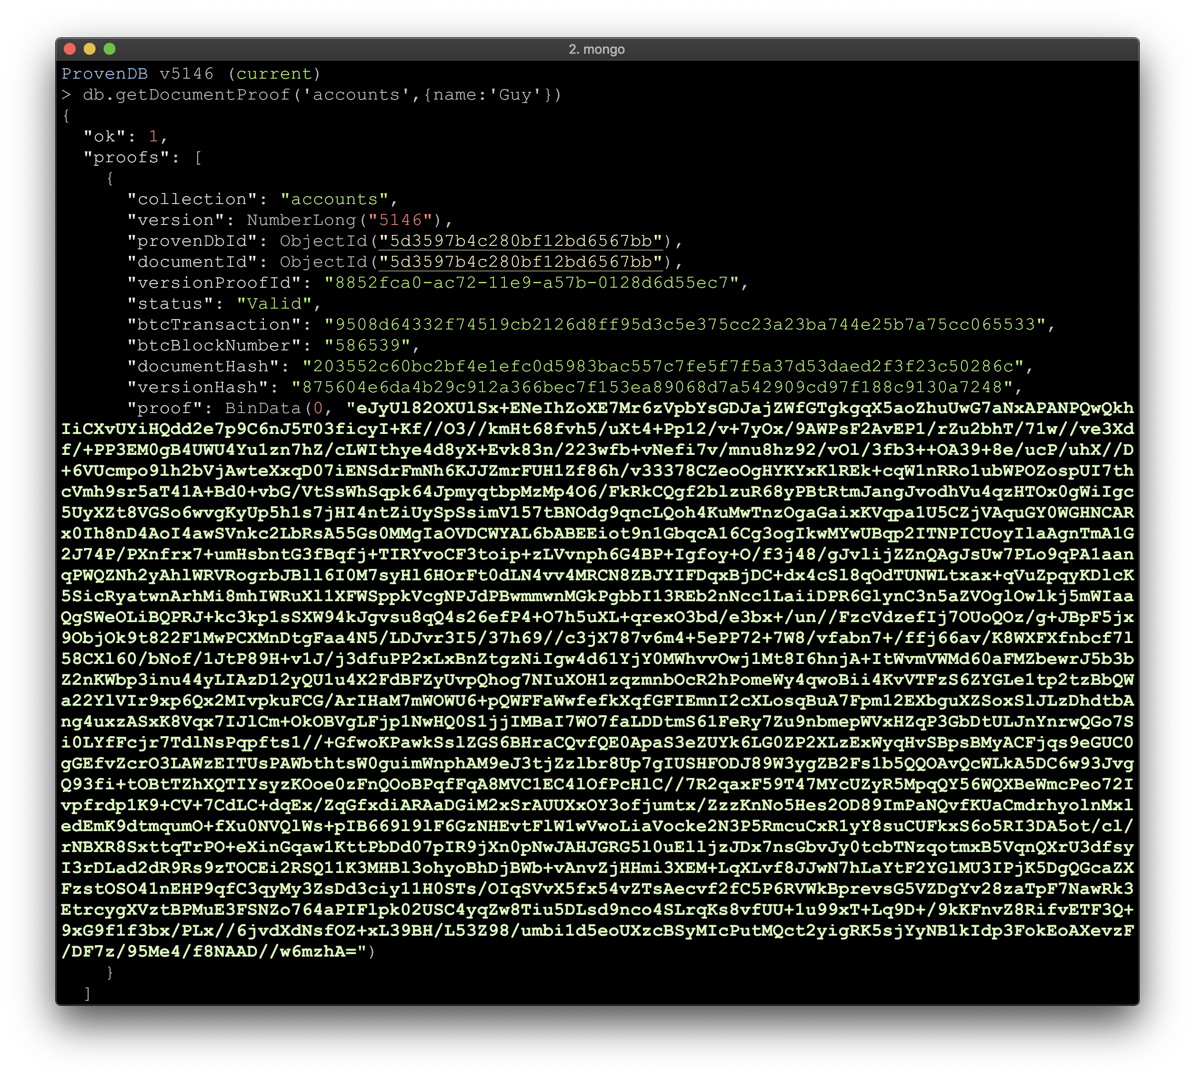
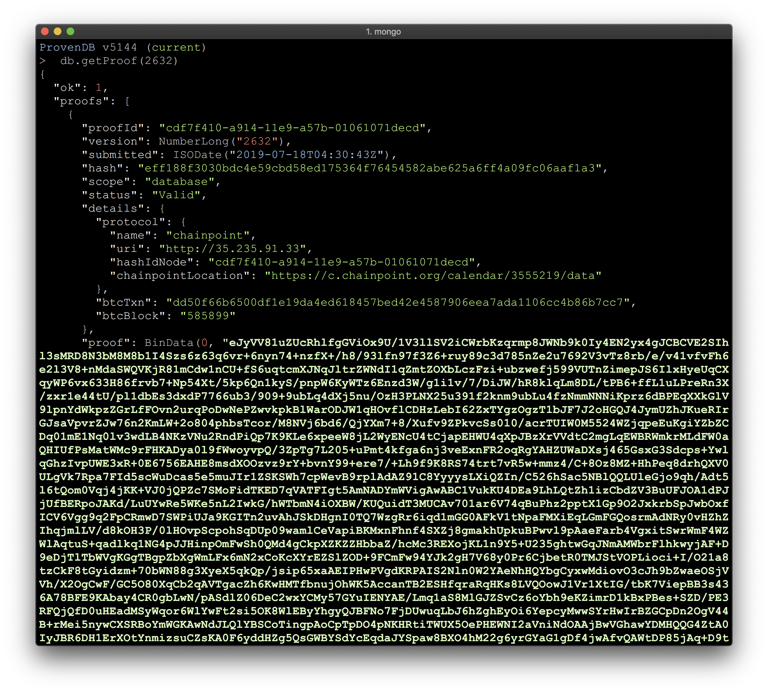
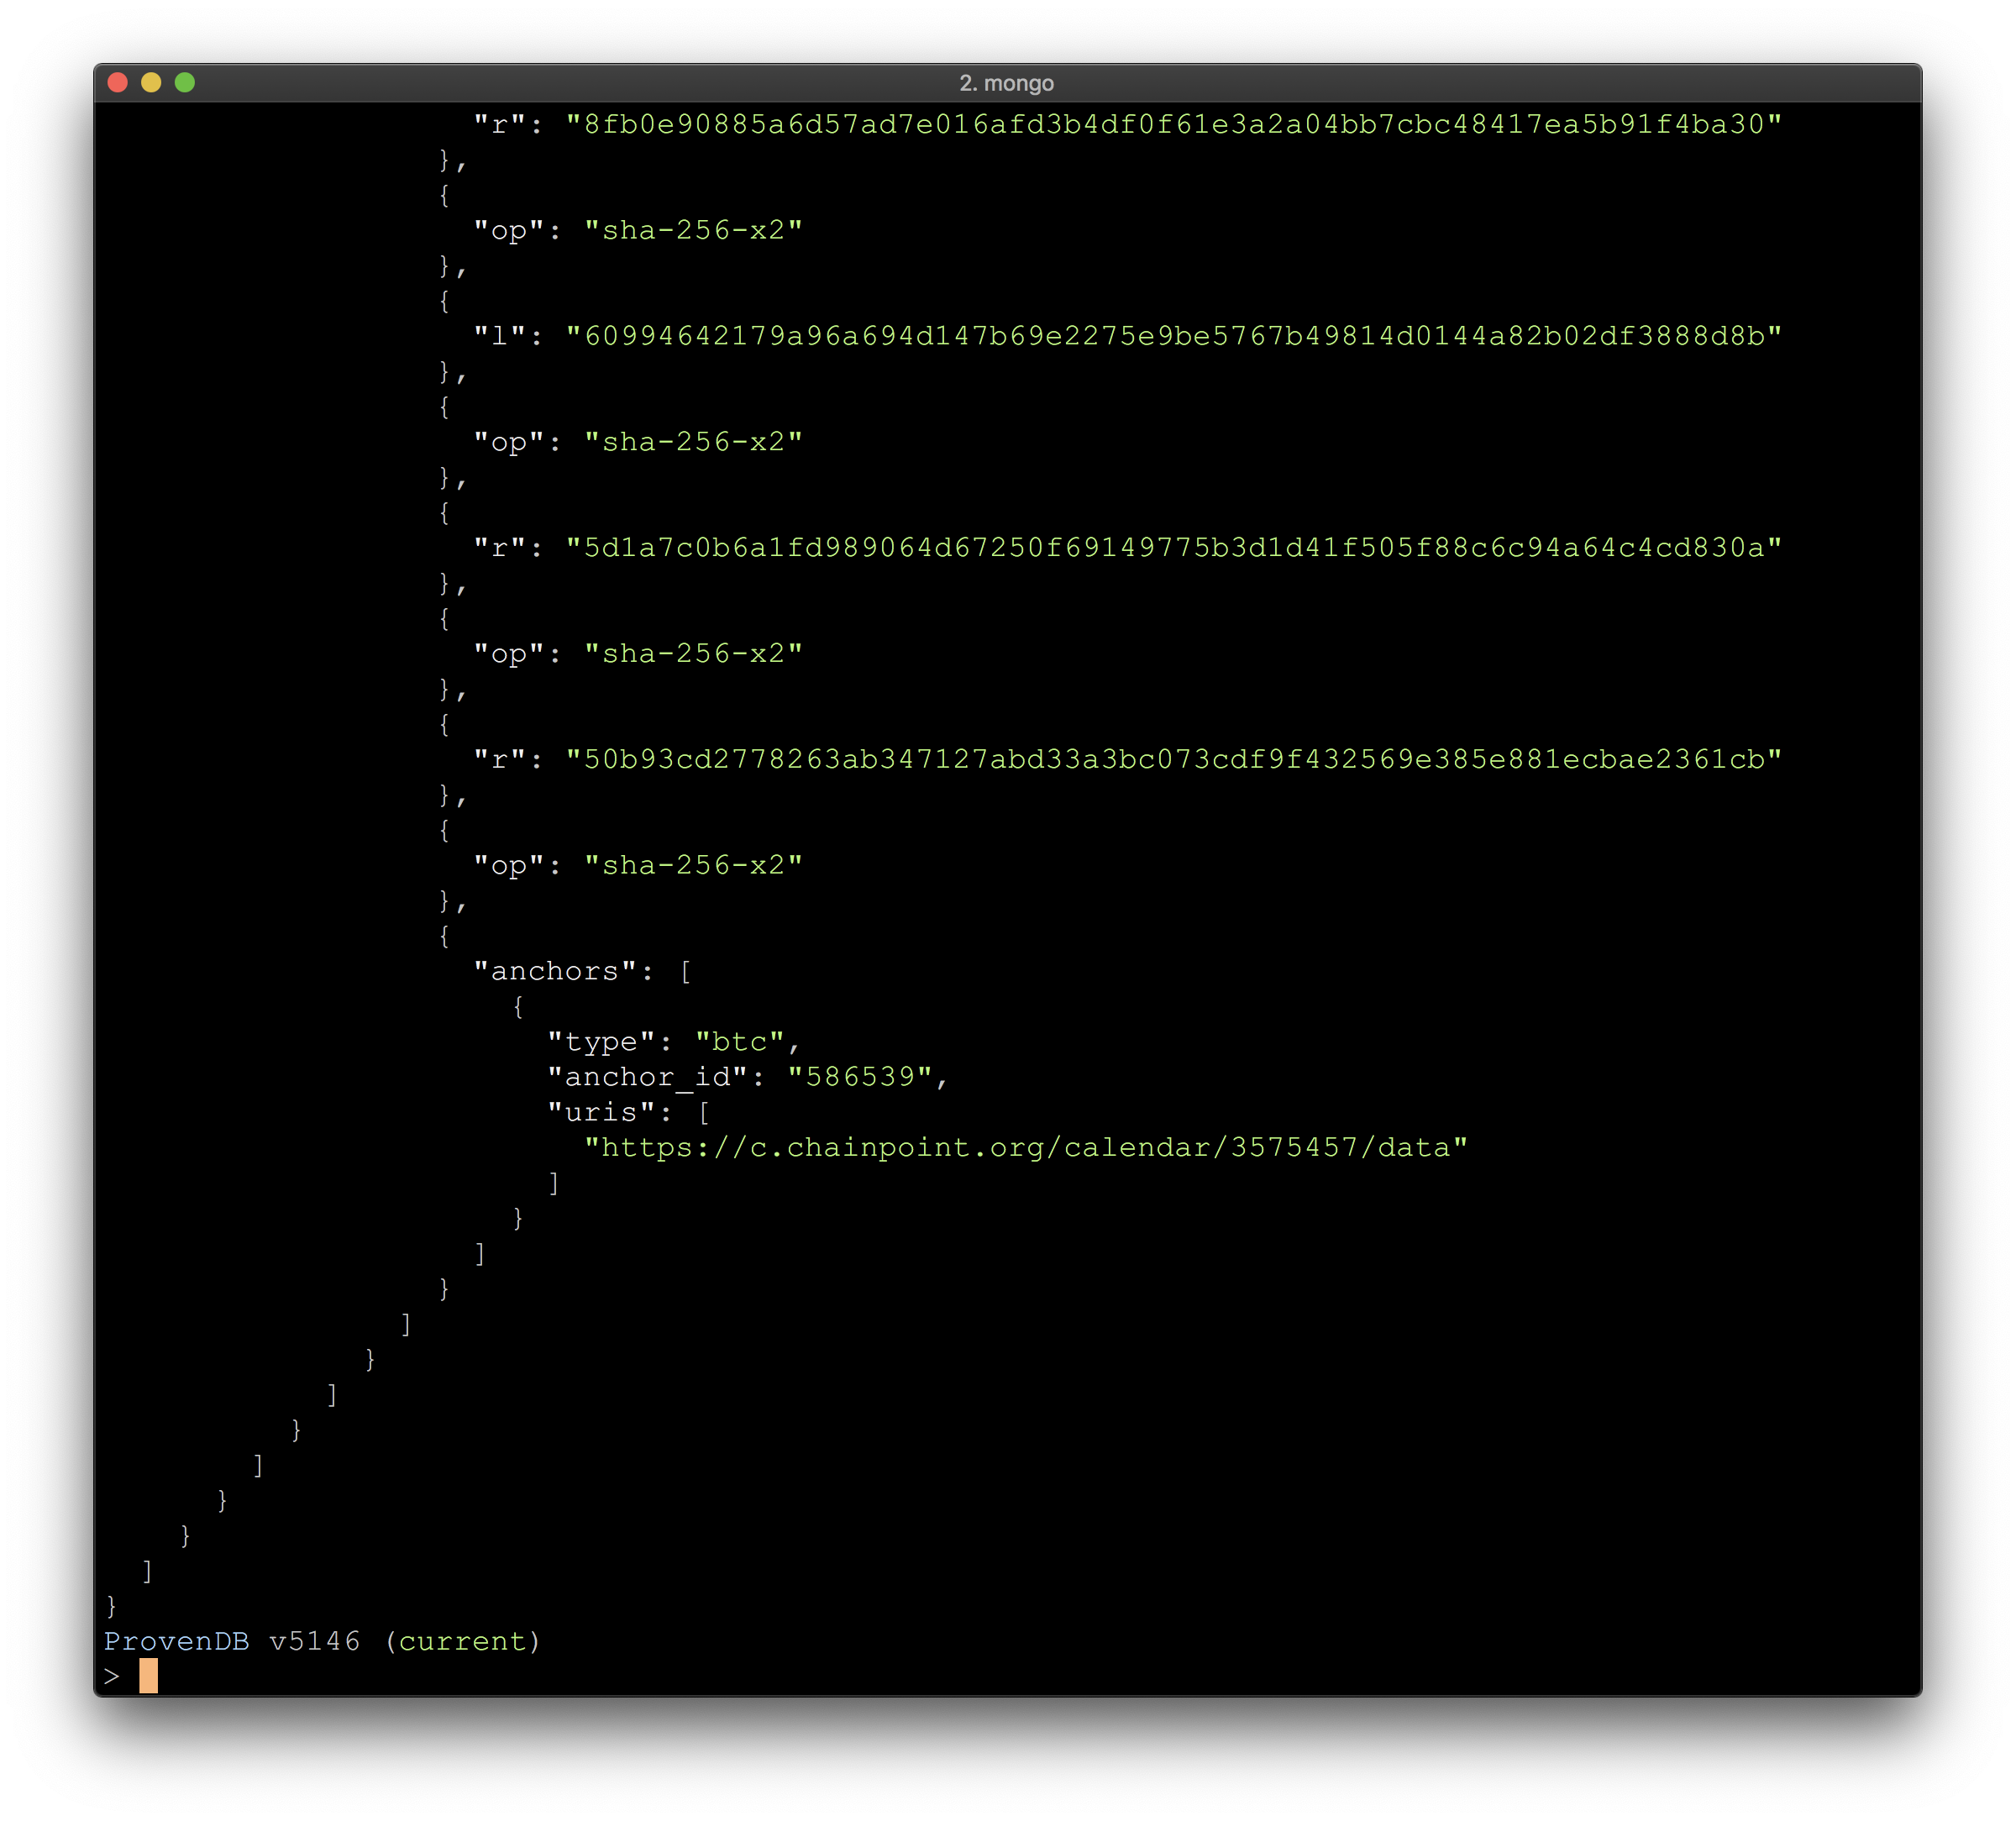
We can retrieve a proof for the entire database version
Or for a specific document
Proofs are in the Chainpoint open standard

Slide 31
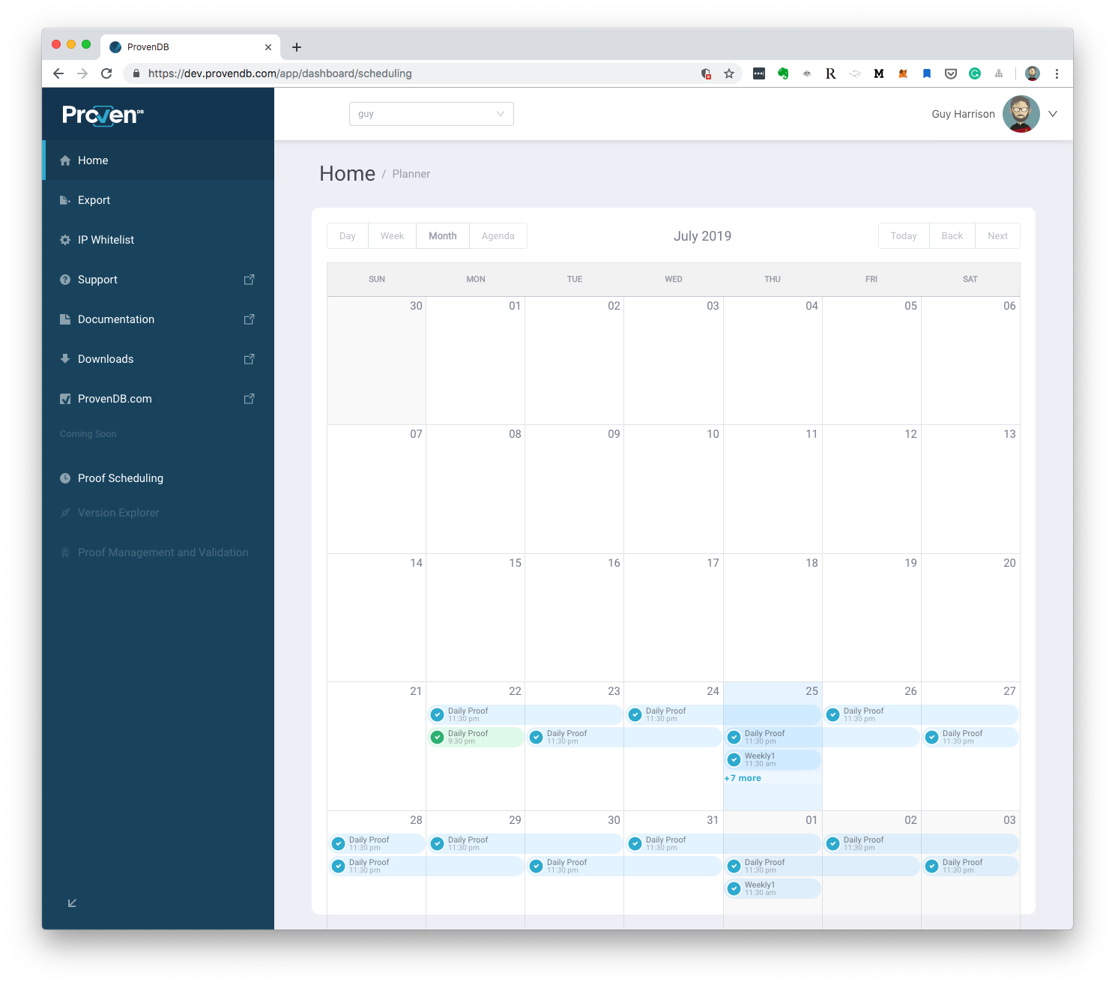
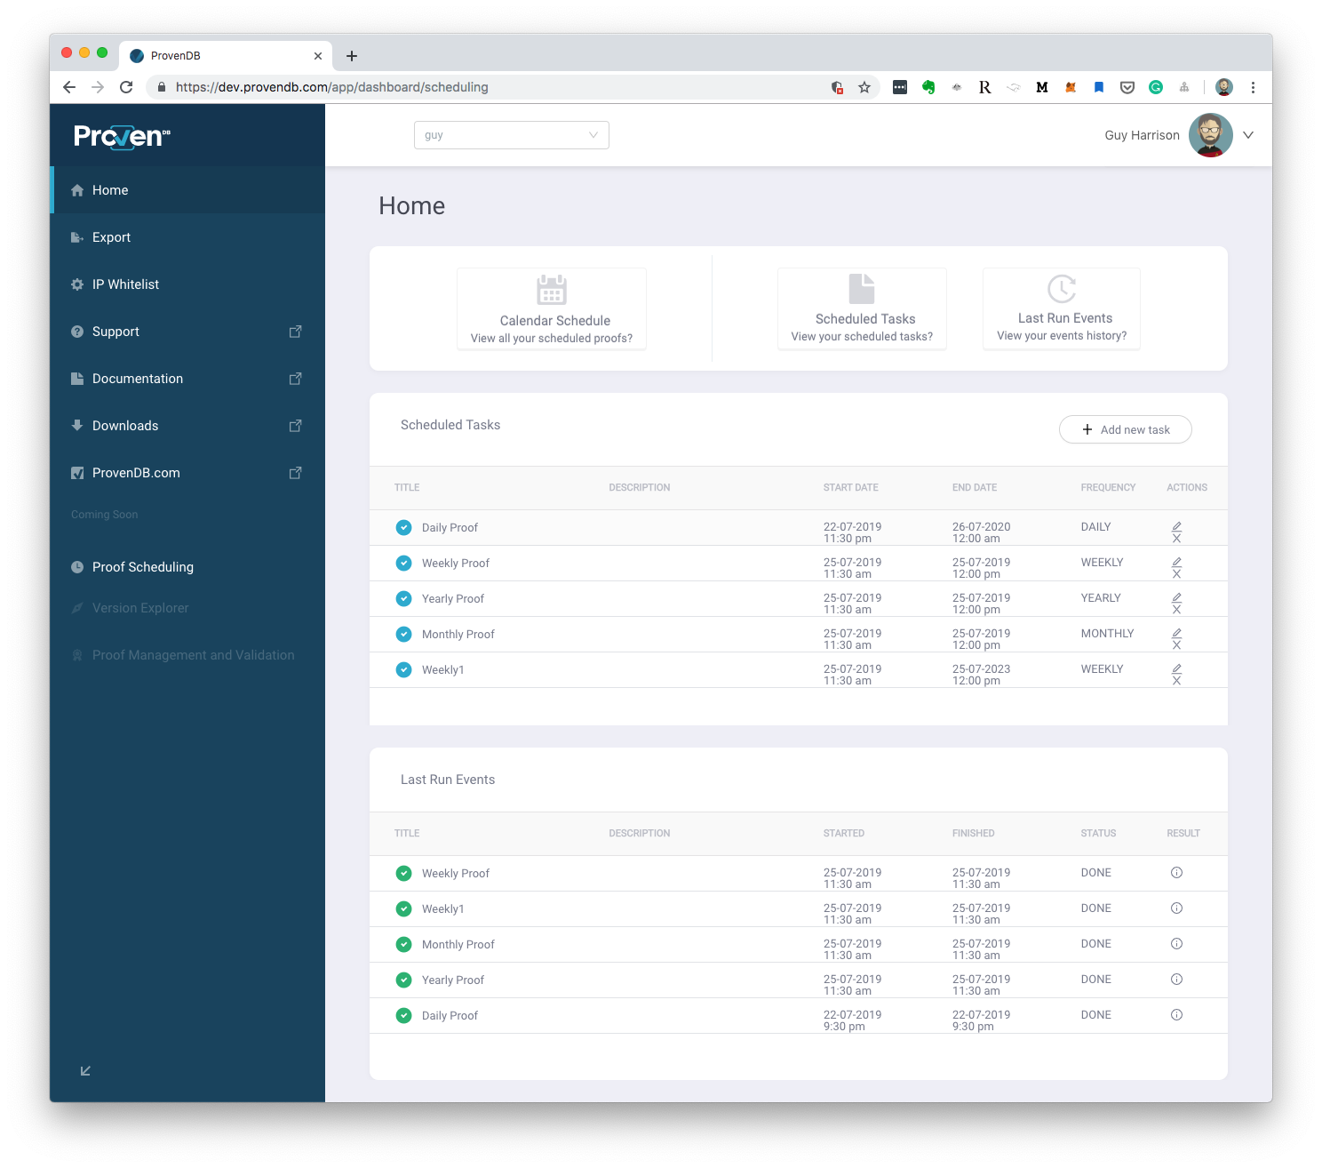
Proofs can be scheduled to run automatically

Slide 32








Features at a glance
Document Model
Fast Bulk Load
Export
Data is stored in MongoDB document format (JSON/BSON).
Bulk loader allows mass data to be loaded into a single version.
Data can be exported to a provable archive completely independent of the ProvenDB system.
Strict Consistency
Full Database Proofs
Compaction
New versions of data are deterministic and serializably consistent.
The entire state of the database can be established with a single Blockchain proof.
Intermediate data between two proofs can be deleted, saving storage without compromising blockchain proofs.
Right to be Forgotten
Single Document Proofs
Data can be redacted without destroying database proofs. GDPR compliant.
Any document in the database can be validated against a Blockchain proof.

Slide 33
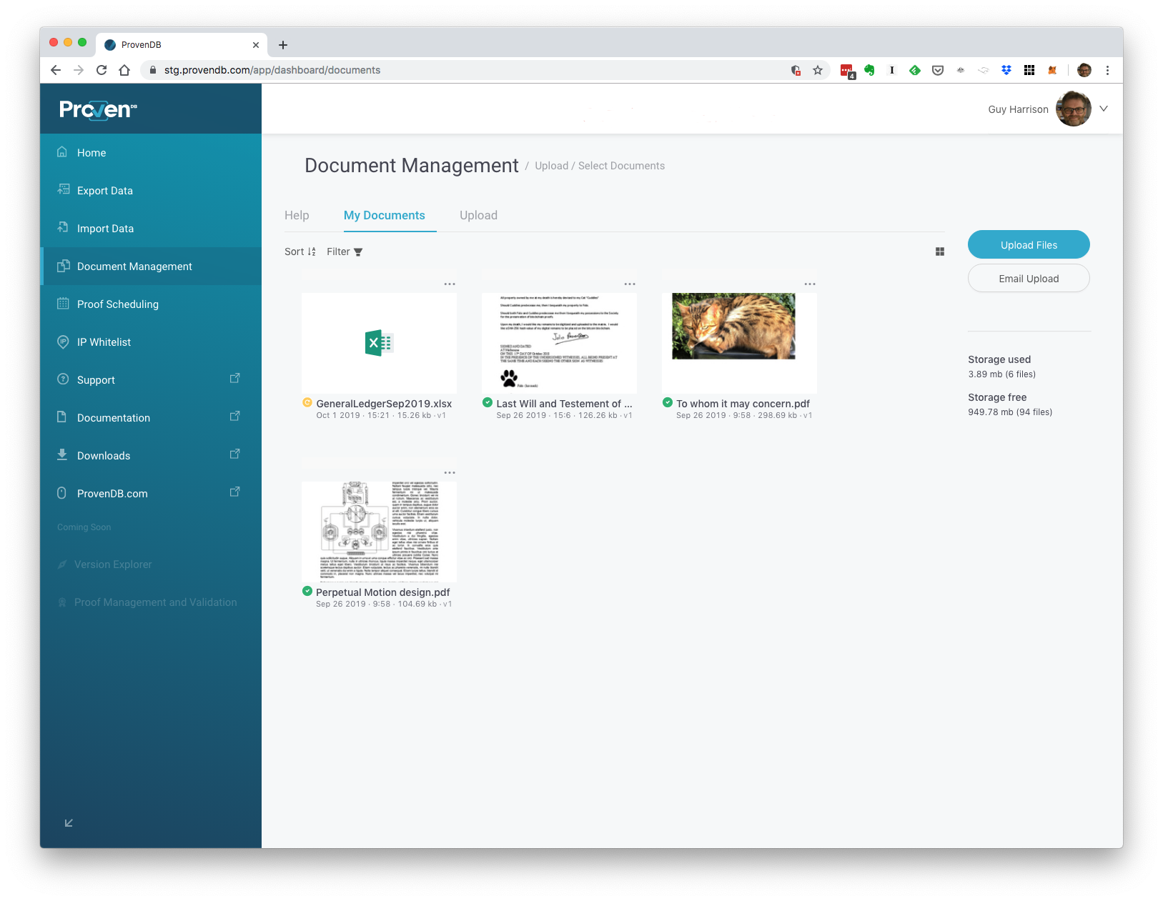
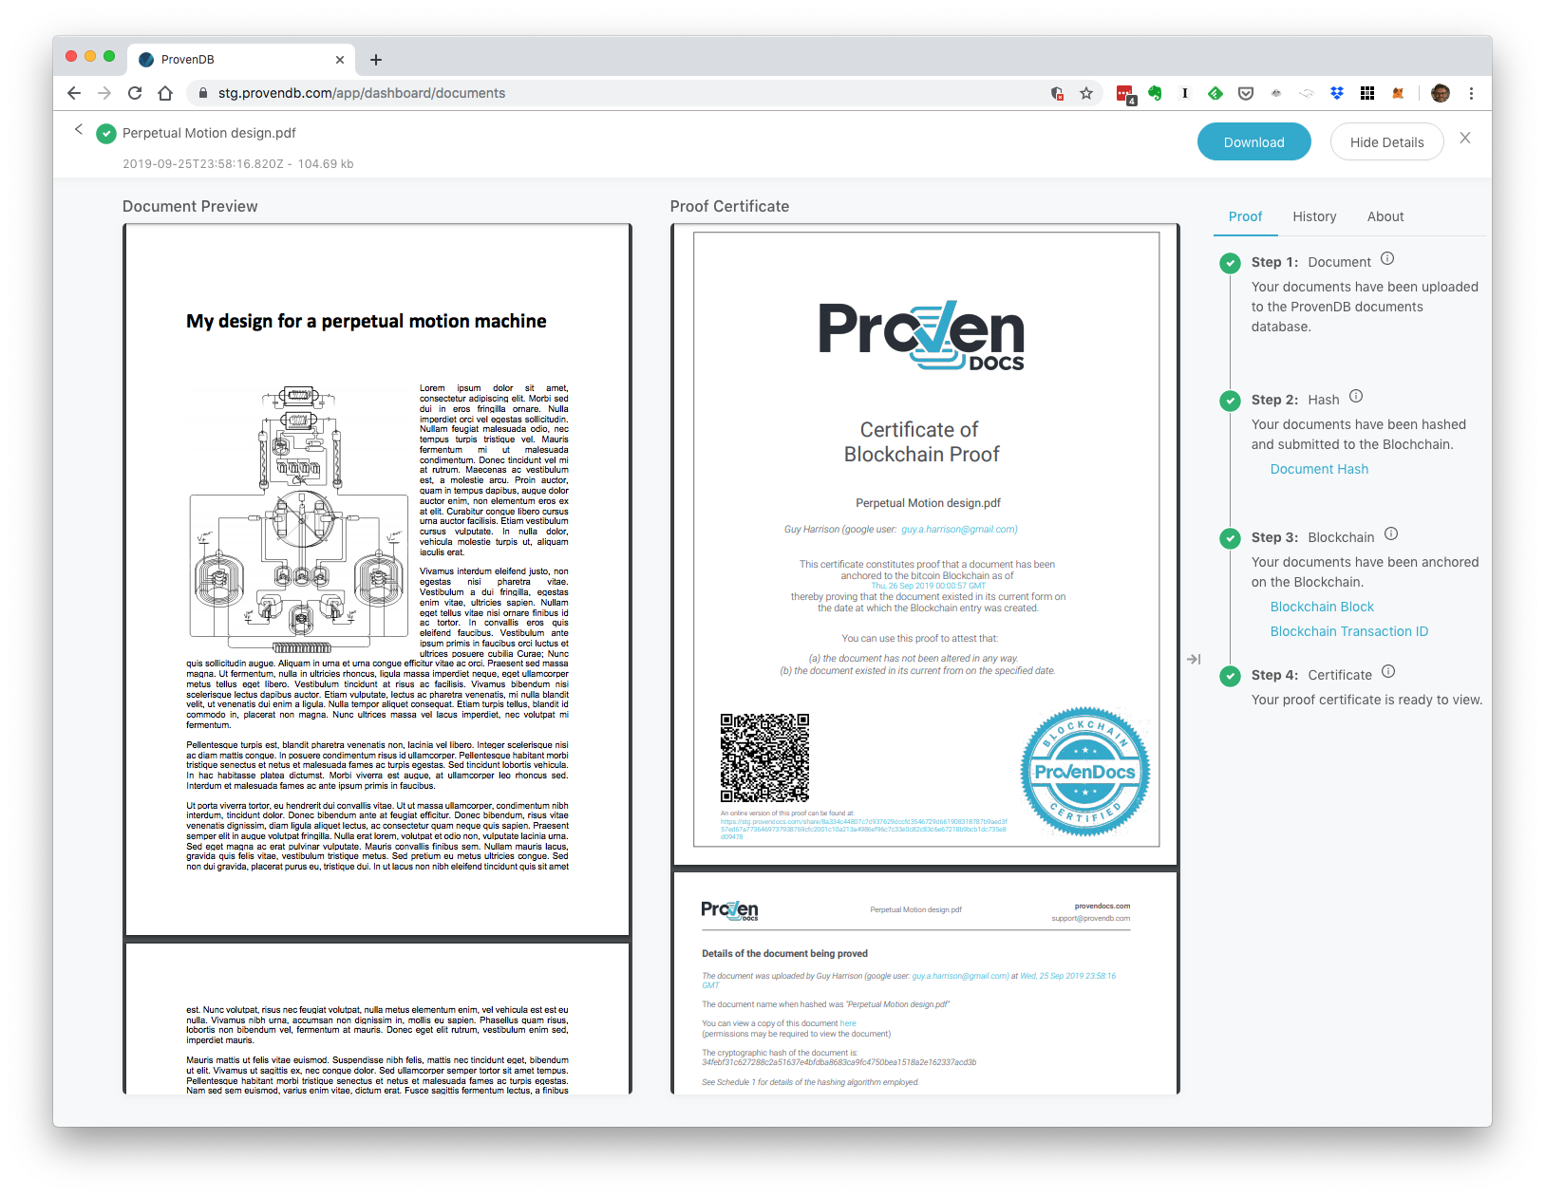
Document Management
ProvenDB offers a User interface for proving and managing individual documents, bypassing the database API

Slide 34
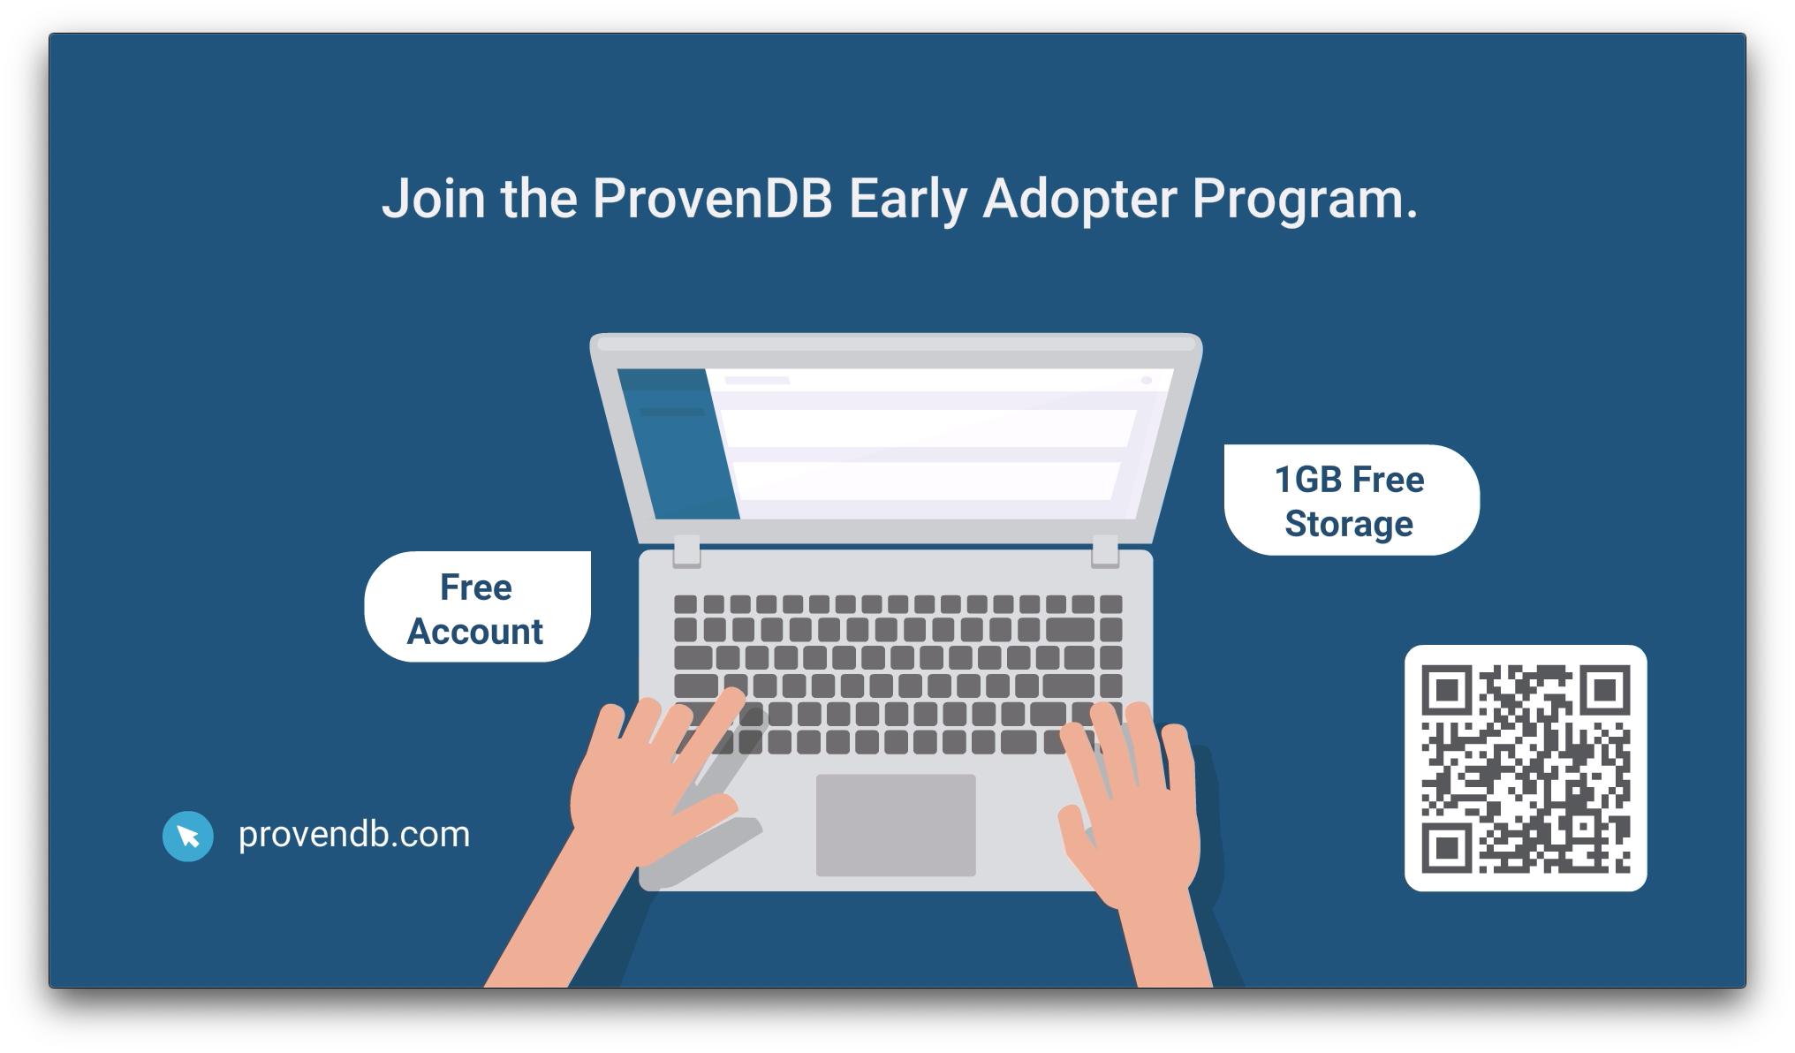

Slide 35

Thank you!
Any questions?
Guy Harrison
CTO ProvenDB
Sign up for a early adopter account at ProvenDB.com
(+61) 418 533 988
guy@provendb.com
/guyharrison
/guyharrison

